Slide 1
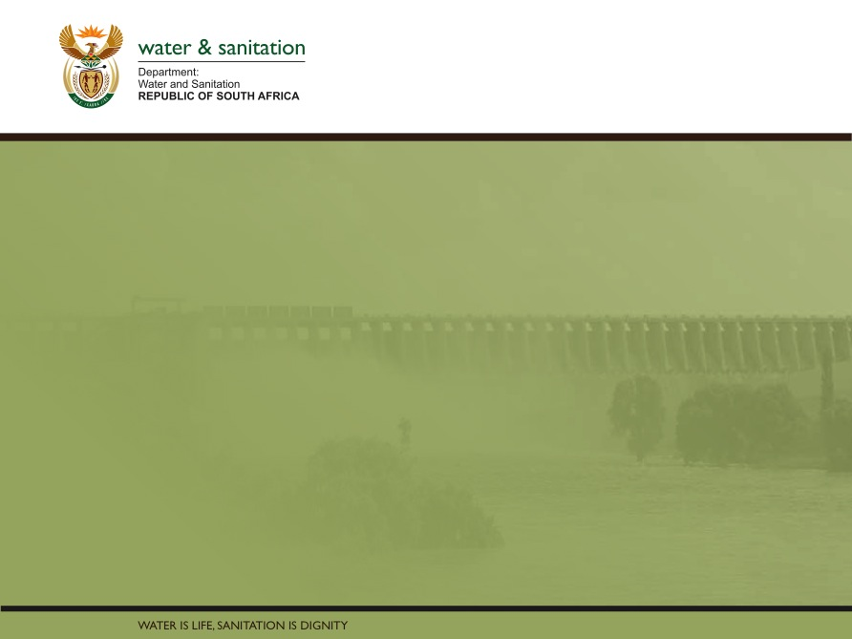
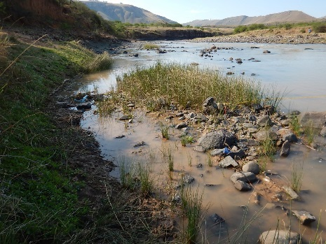
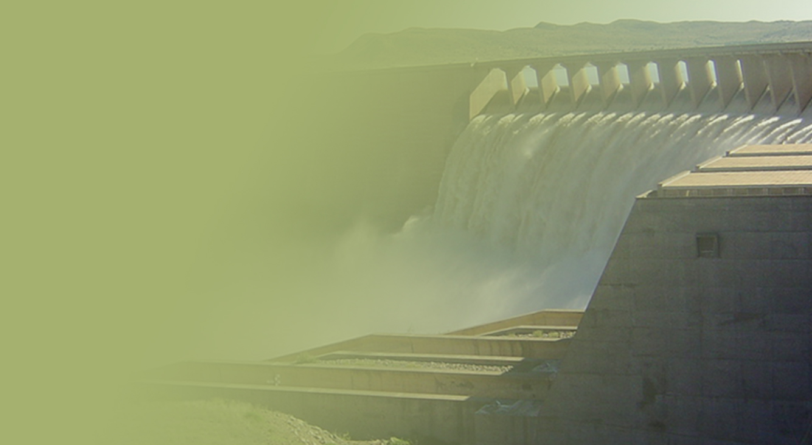
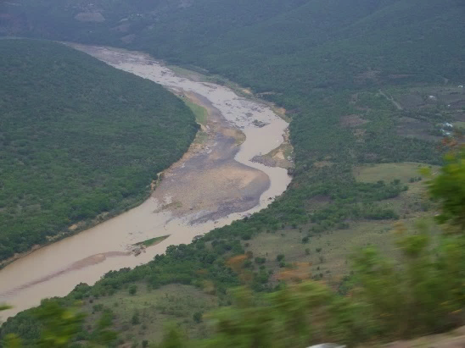
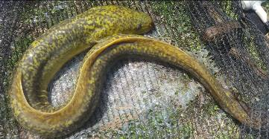
WP 11004: STAKEHOLDER MEETINGS,
JUNE 2018
PRESENTATION TITLE
Presented by:
Name Surname
Directorate
Date
DETERMINATION OF WATER RESOURCE CLASSES AND RESOURCE QUALITY OBJECTIVES FOR THE WATER RESOURCES IN THE MZIMVUBU CATCHMENT
Delana Louw and Patsy Scherman

Slide 2
Project Plan

Slide 3
Contents of Presentation
What is Classification?
What is happening today in the study area? – Status Quo
How could things change in the study area? - Scenarios
How do we balance the different needs/demands? (Ecological requirements, i.e. the Reserve and use)
What are Water Resource Classes?
How do we implement and monitor Classes? (Resource Quality Objectives)
Notes:
PSP to present:
Bullet 1: The classification presentation will cover:
Description of the water resources in the Letaba River System.
Sub division and components.
Statement on the water supply situation.
Bullet 2: RQOs describes the detail conditions that need to be met to achieve the required protection set by the Management Class.
This is in the form of numerical of descriptive statements defining the management goals of the water resource.

Slide 4
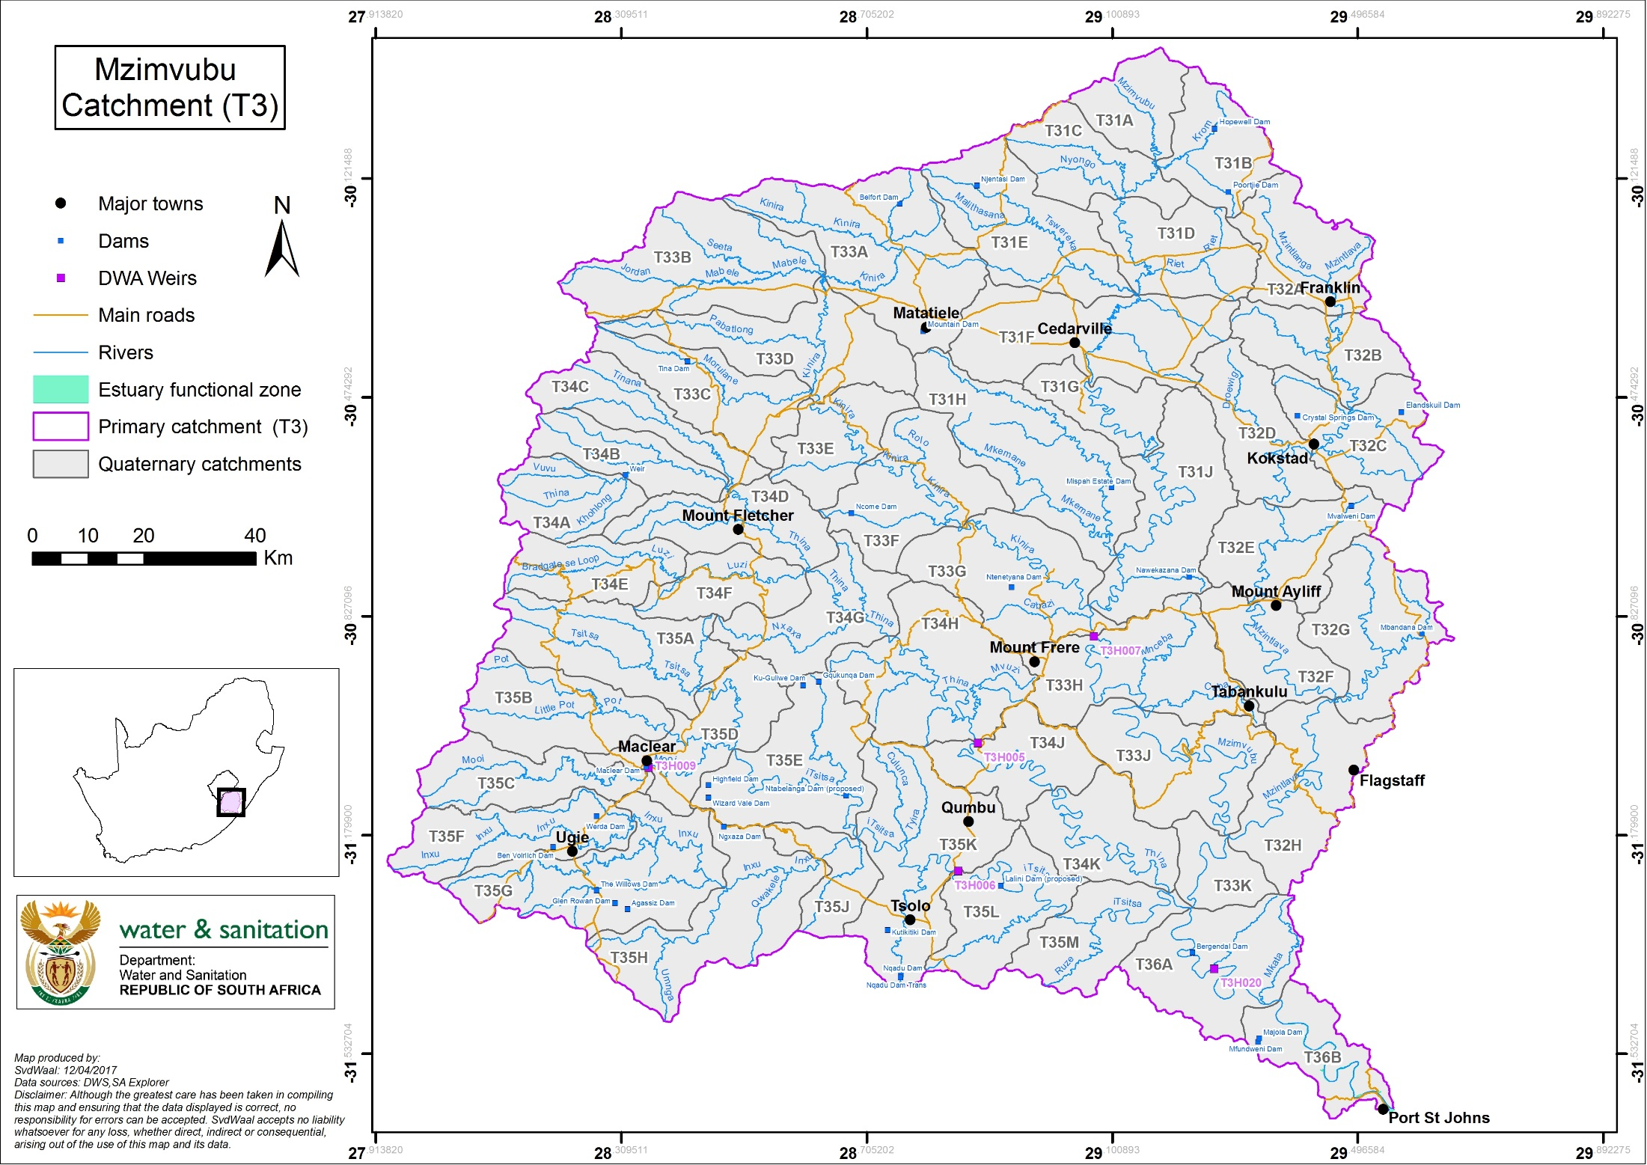

Slide 5
CLASSIFICATION
– how does it work?

Slide 6


What is Classification?
Balance between
Protection
(Ecology)
Use
&
includes Water balance, user quality, socio-economics
Expressed as Ecological state

Slide 7






How is Classification described?
Ecology
Use
CLASSES | DESCRIPTION
I | Ecology: Mostly in good condition. Use: Minimal
II | Ecology: Mostly in moderate condition Use: Medium
III | Ecology: Mostly in poor condition. Use: High, so a work-horse river.

Slide 8

How is ecology described?
Close to Natural: Good condition
Very different to Natural: Very Poor condition
{
{
Categories

Slide 9
What scale do we classify at?
Classify every Integrated Unit of Analysis (IUA)
IUAs are similar ito land use &/or ecological state. So, an IUA consist of many river reaches and/or estuaries.
Provide the Catchment Configuration for every IUA (Provide the ecological state for each of the river reaches and estuaries).
Ecological state can be the Present Ecological State (PES), a Recommended Ecological Category (REC), or a Target Ecological Category (TEC; for management purposes) once classified.

Slide 10
IUAs and Catchment
configuration
IUA 2
IUA 1
IUA 4
IUA 3

Slide 11
How do we classify?
Gather relevant information
Build a step-by-step picture of the study area in terms of water resources:
–present uses and implications
– the ecological state and water requirements
– future needs (ecological and user)
Determine a balance – and implications
Apply numerous analysis tools

Slide 12
Aspects considered in Class determination
Ecological Water Requirements:
  83 Resource Units with biophysical sites and 1 estuary.
User water requirements (How much water is used and discharged?):
  Quantity and quality
Hydrological assessment (How much water is available?):
  Applied available data and models
Socio-economic activities relying on water:
  GDP, Jobs (water stored and abstracted as well as waste water discharges)
  EcoSystem Services (use of water in the rivers)

Slide 13
WATER RESOURCES
What is happening today?
(Status quo)
Is improvement necessary?

Slide 14
WATER USE
Afforestation: 2.6% of catchment (mostly middle to upper Tsitsa)
Irrigation: 0.7% (Mostly in parts of Mzimvubu, Mzintlava and Tsitsa)
Alien invasive plants: 1.7% (not representative of riparian zones – will be higher)
Water use (municipal and farm dams, abstractions etc.): Present day flows are 95% of natural
NOTE: Catchments with no stress in terms of water balance – no improvement necessary

Slide 15
ECOLOGY
What is happening today?
(Status quo)
Is improvement necessary?
- Rivers
- Estuaries
- Wetlands

Slide 16
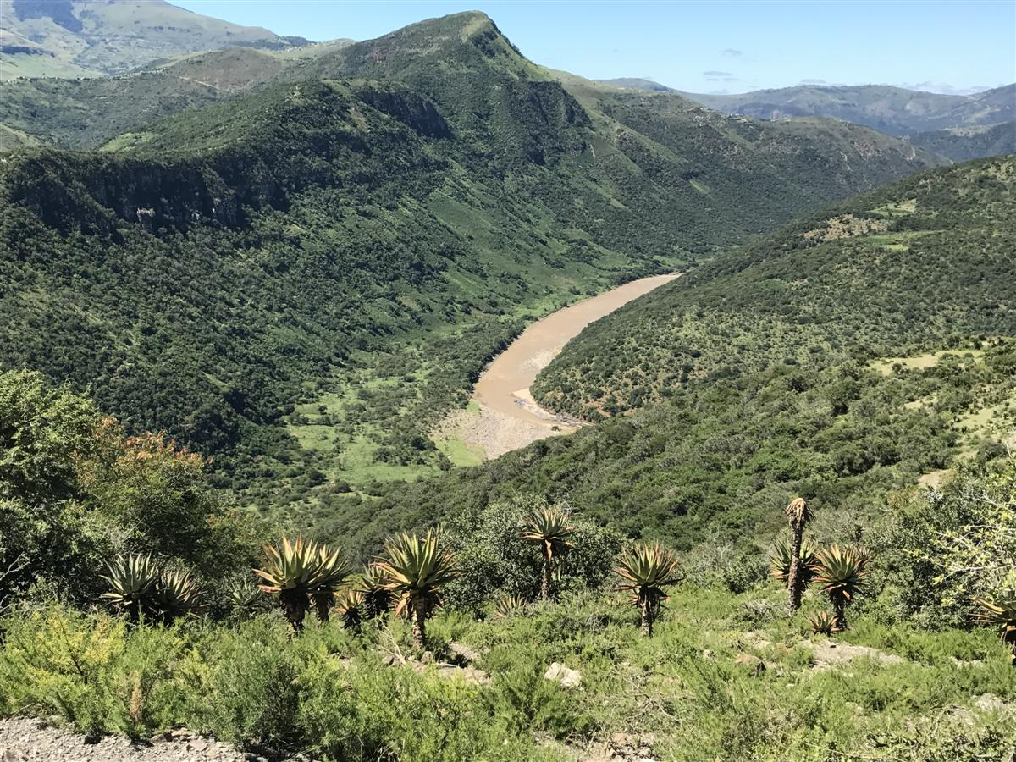
Rivers
Wetlands
Estuaries

Slide 17


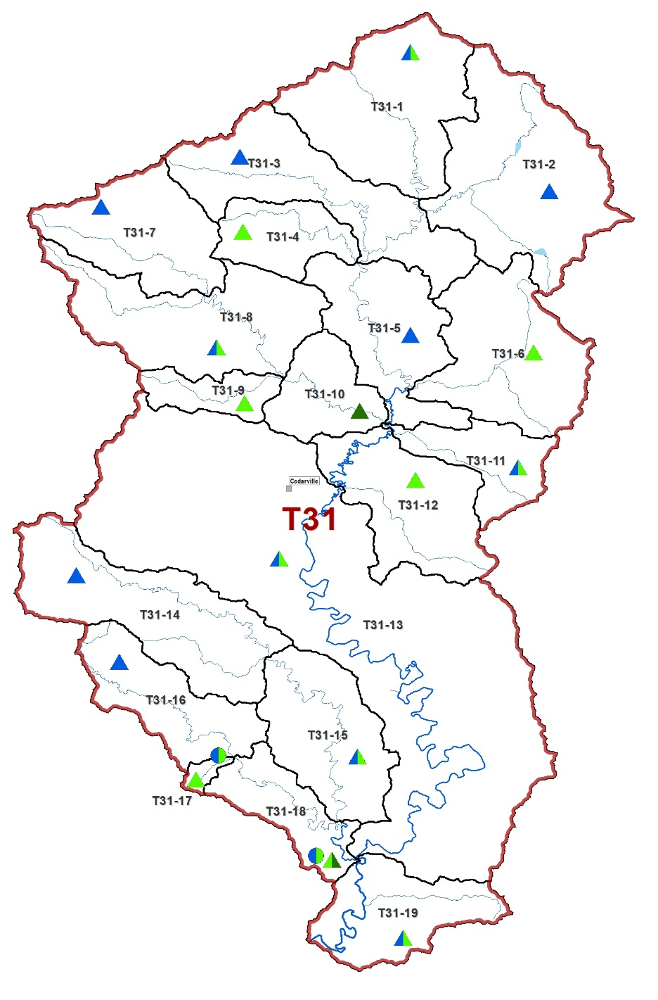

T31: Mzimvubu
RIVER ECOLOGY: STATUS QUO
Mostly good to moderate condition: farming, grazing, erosion, alien veg.
Mostly moderate condition:
Formal farming (irrigation, grazing)
Mostly good condition:
Mountains, agriculture, erosion, grazing
&

Slide 18
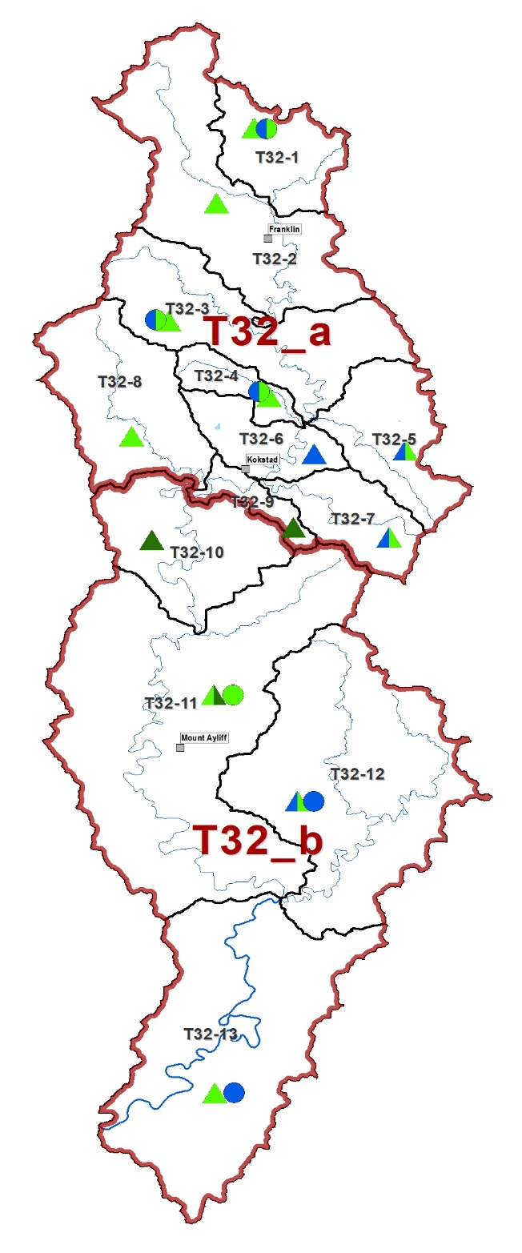



RIVER ECOLOGY: STATUS QUO
T32: Mzintlava
Mostly in moderate condition:
Dryland agriculture, irrigation, grazing. Kokstad in lower reaches: D category
Some moderate to poor condition:
Dryland farming, grazing, rural villages, extensive erosion.

Slide 19
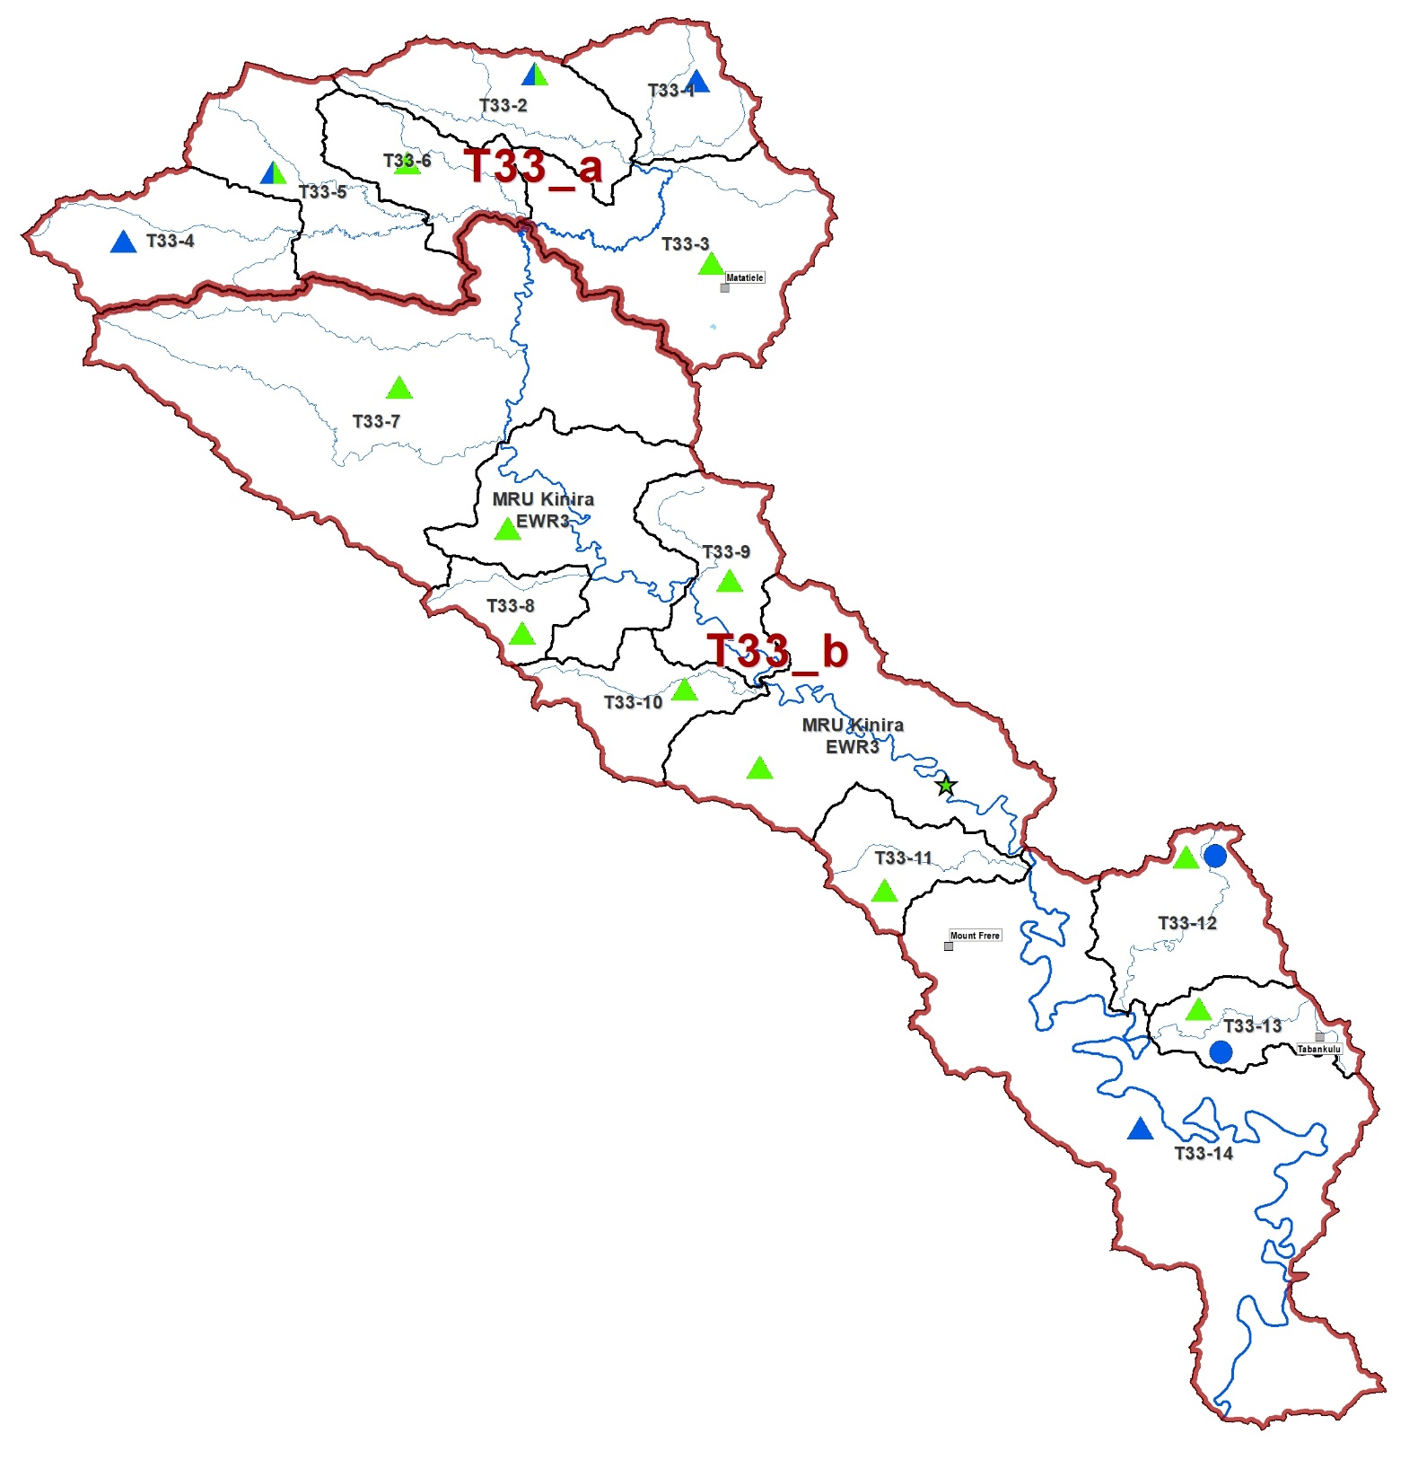
RIVER ECOLOGY: STATUS QUO
T33: Kinira
Good to moderate condition:
Mountainous upstream area with dry land cultivation in lower areas with oxbows
Moderate condition:
Mountainous upstream area with dry land cultivation. Lower areas consist of gorges and dry land cultivation

Slide 20
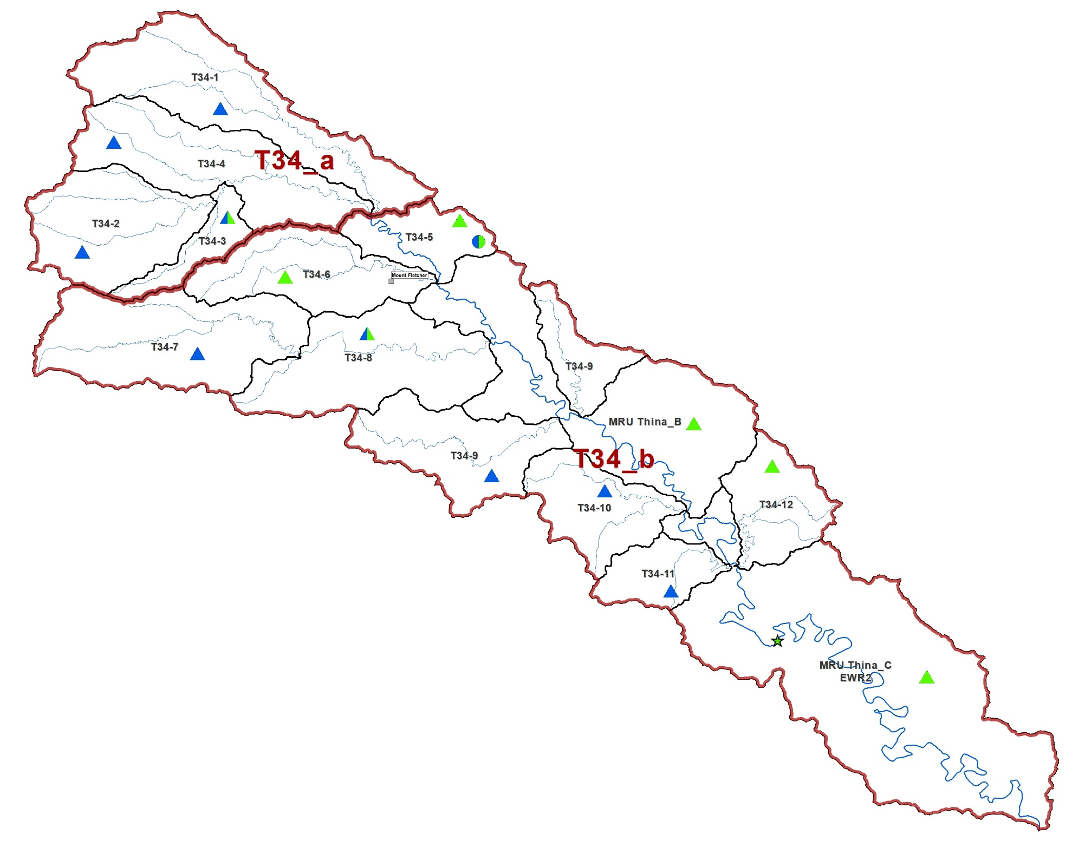
T34: Thina
RIVER ECOLOGY: STATUS QUO
Mostly good condition:
Impacts non-flow related (dry land cultivation, and alien vegetation)
Good to moderate condition:
Upstream areas: Mount Fletcher, erosion, alien vegetation. Further downstream - dryland cultivation, grazing, alien vegetation, areas with severe erosion and high human density. The downstream area is a gorge with some extensive erosion due to over grazing; also a large weir.

Slide 21
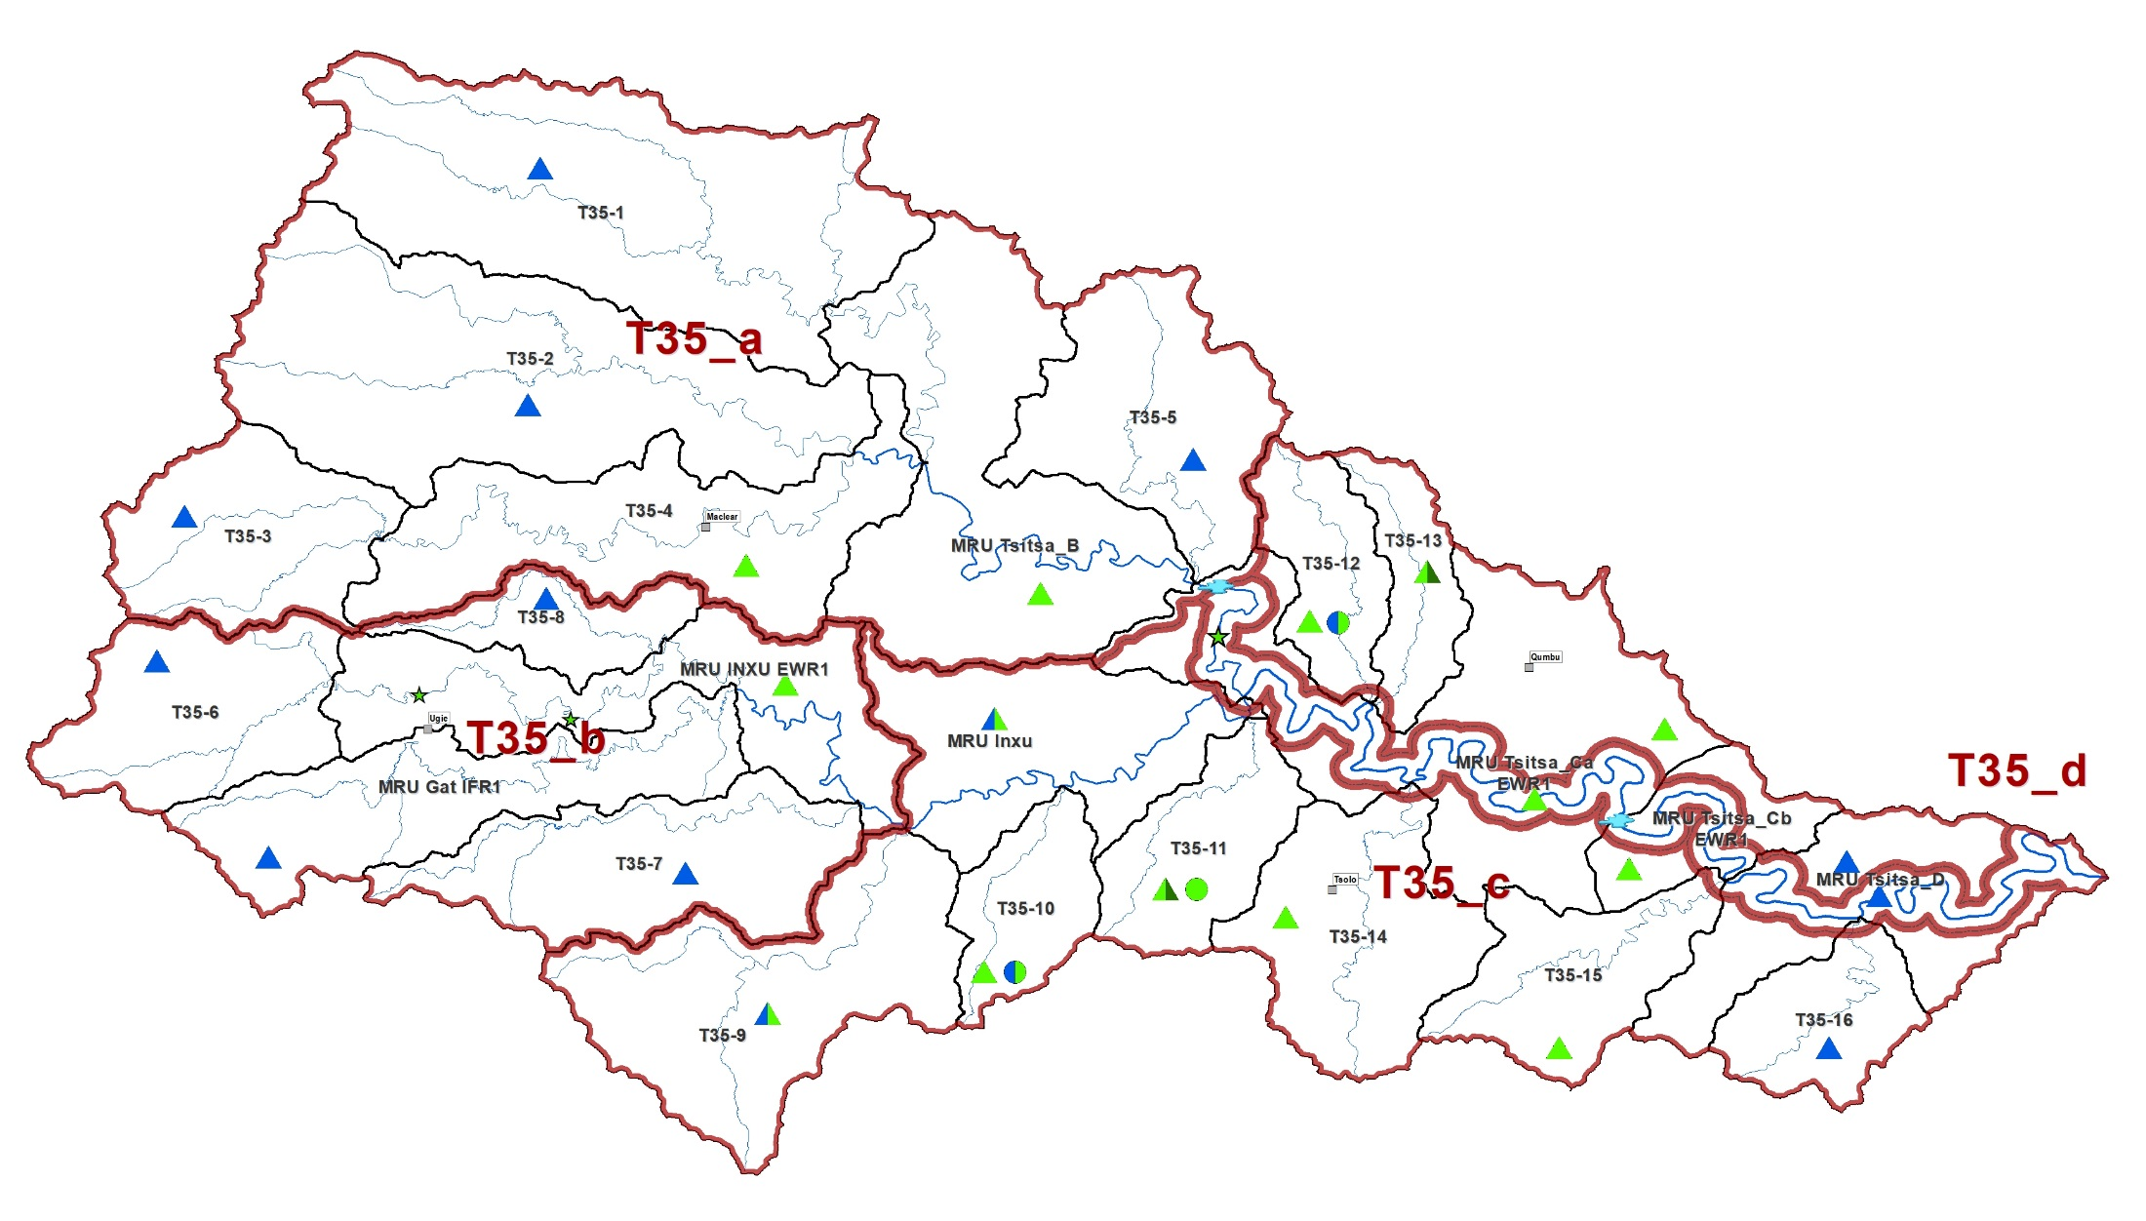




RIVER ECOLOGY: STATUS QUO
Mostly good with some moderate condition:
Forestry in mountains. Alien vegetation, cultivation and grazing. Erosion in lower areas.
T35: Tsitsa
Mostly moderate condition:
Main river, erosion, aliens and gorge sections.
Mostly good with some moderate condition:
Forestry, alien vegetation (water quality issues at Ugie)
Mostly moderate with some good condition:
Dry land cultivation & grazing, severe erosion in places. Gorge: better condition.

Slide 22
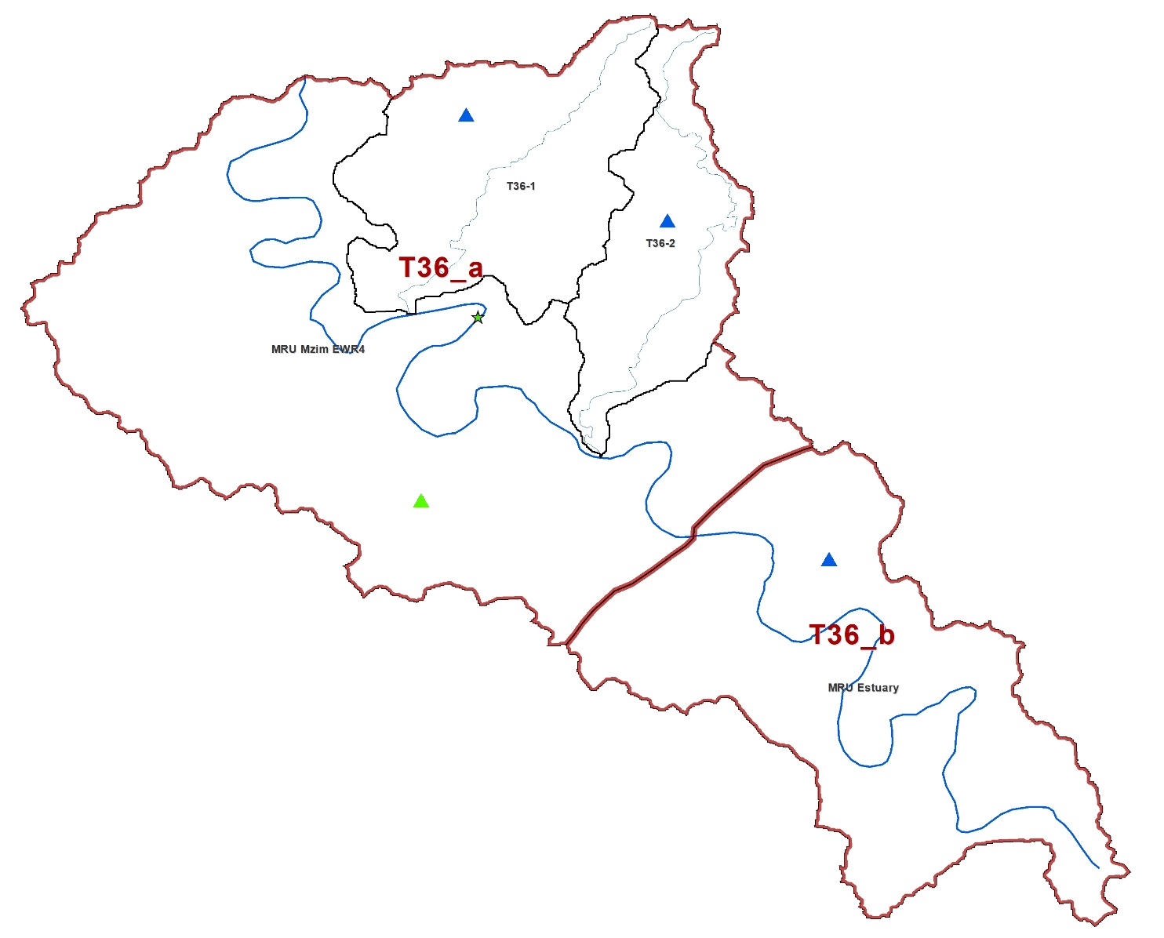
T36: Mzimvubu
RIVER ECOLOGY: STATUS QUO
Main river moderate and tributaries good condition:
Mostly gorge, dry land cultivation, large gauging weir in main river, grazing, some erosion.

Slide 23
Is improvement necessary?
Improvement is necessary if:
Ecological importance is High or Very High
(apply a set of rules for rivers and estuaries)
Rivers or estuaries are in a very poor condition – then potential and difficulties for improvement are assessed.
82 Resource Units assessed:
14 river reaches require improvement.
64% must be improved through measures other than flow.
36% require a combination of flow and non-flow measures

Slide 24
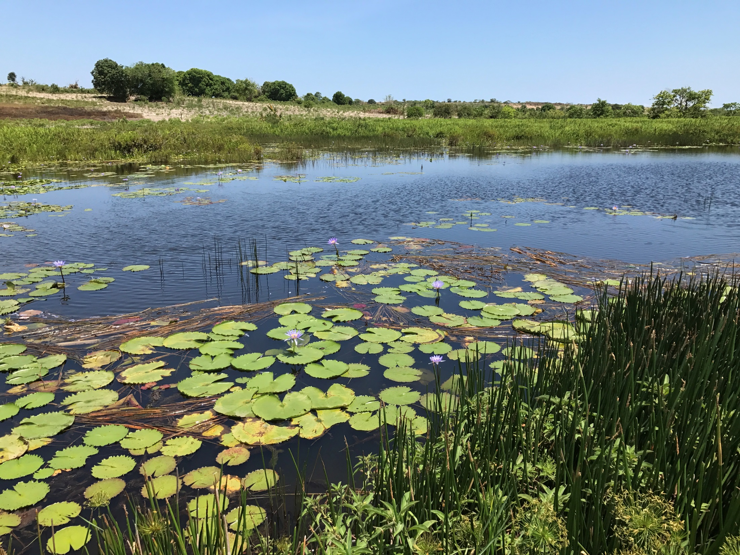
Rivers
Wetlands
Estuaries

Slide 25
Wetland status quo
About 16 000 wetlands in study area.
Wetland prioritisation undertaken according to a number of metrics at a desktop level:
  present ecological state
  ecological importance
  socio-cultural importance
A status was allocated on a quaternary catchment basis.
Highest Priority wetlands:
  Matatiele floodplains
  Mzimvubu floodplains
  Gatberg floodplains

Slide 26
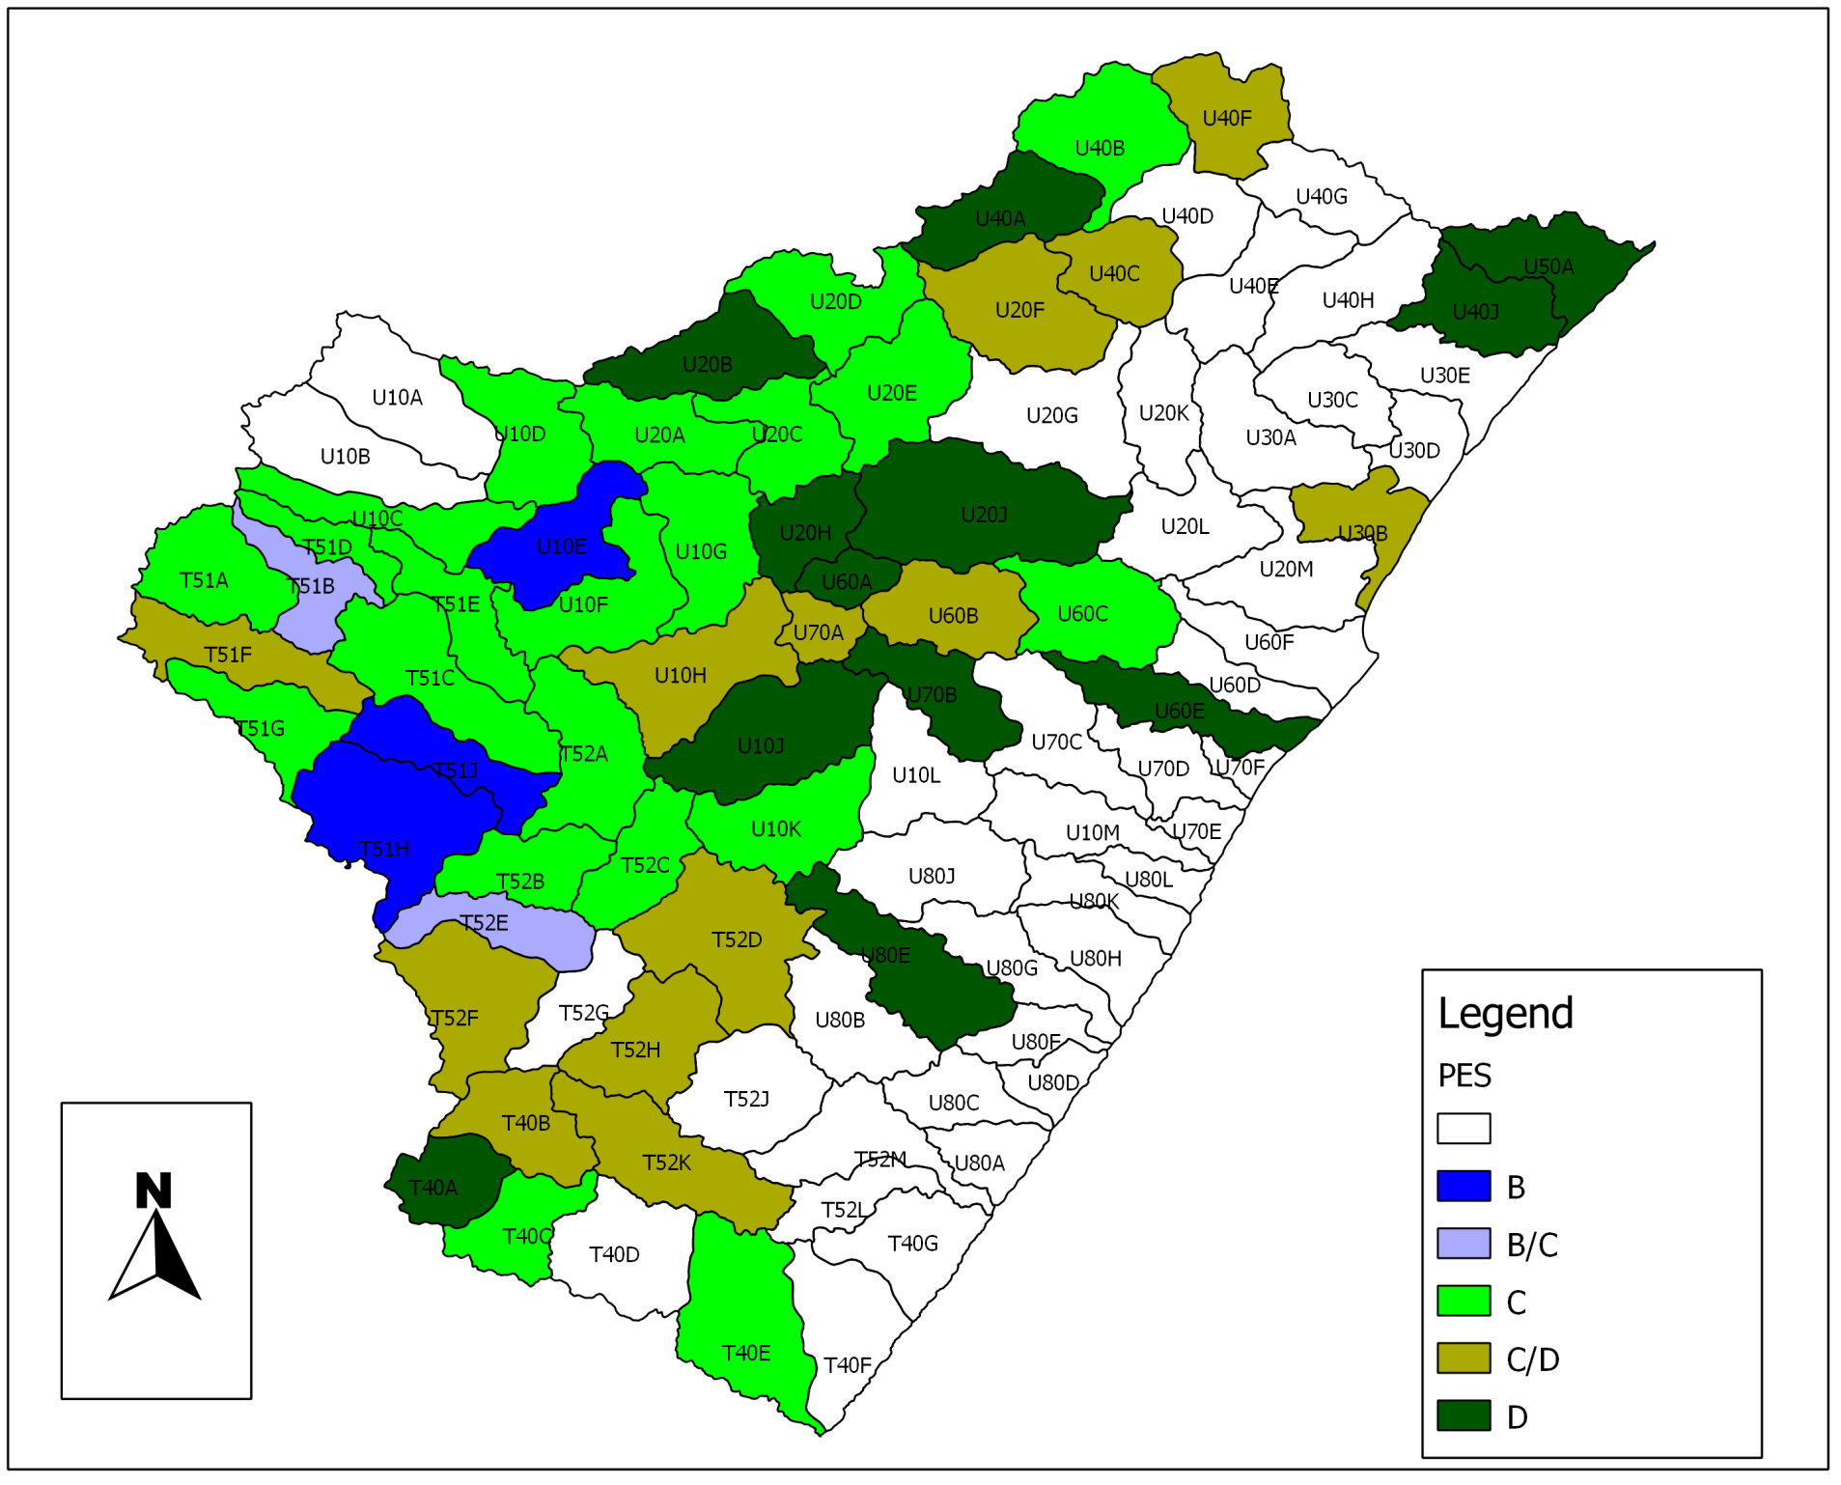



Wetland ecological status quo
Good
Moderate
Poor

Slide 27
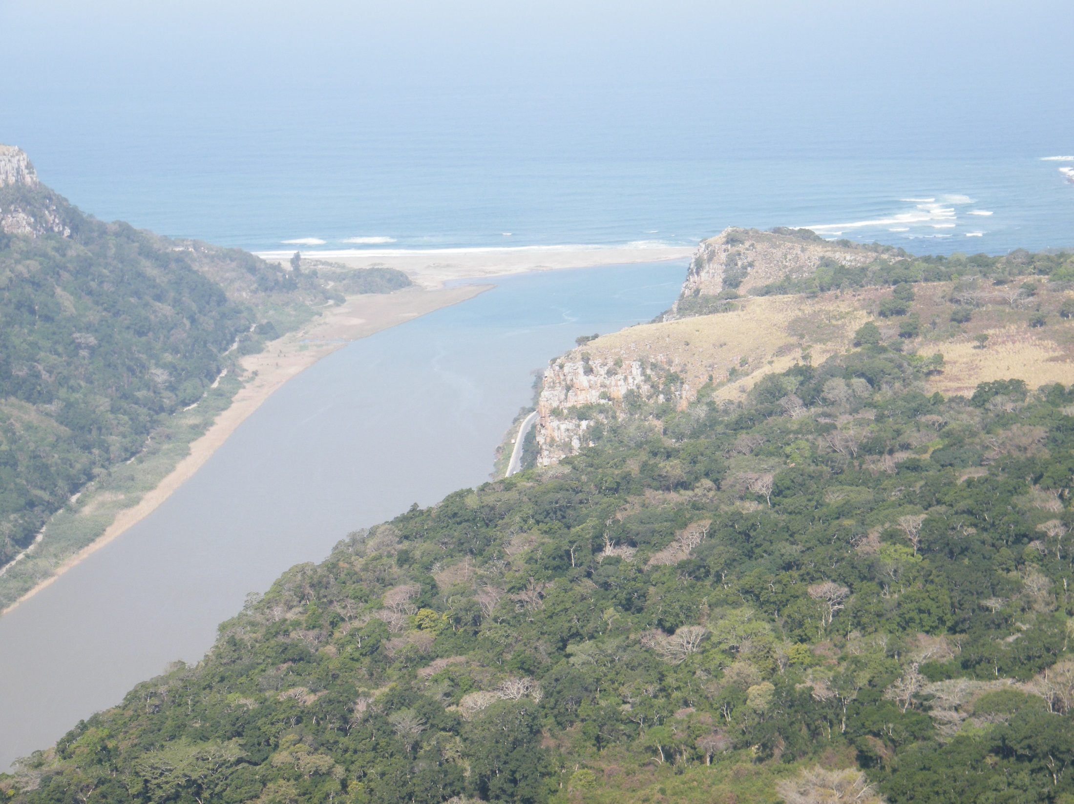
Rivers
Wetlands
Estuary

Slide 28
KEY PRESSURES
Pressure |  | Comment
Water abstraction/dams |  | Limited water abstraction, but no large dams
Agriculture |  | Overgrazing in some areas
Municipal waste water |  | Pollution risks from Port St Johns
Bridge(s) and roads |  | Road entrained estuary mouth (at “First Beach”)
Recreational fishing |  | High pressure
Subsistence fishing (e.g. gillnetting) |  | High pressure
Poaching |  | Known to occur
Alien fauna and flora |  | Invasive alien plants in EFZ and catchment
Disturbance of birds |  | Various human activities in EFZ

Slide 29
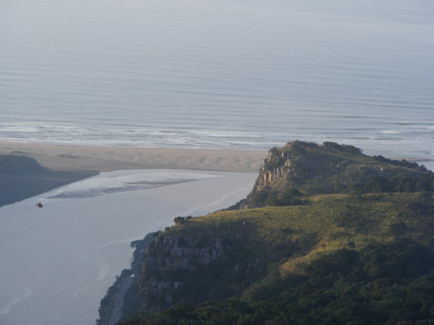


Hydrology Water quality Invertebrates Physical habitat changes
Mouth condition Microalgae Fish
Macrophytes Birds

Slide 30
WATER RESOURCES
What is the future situation?

Slide 31
Classification within Integrated Water Resource Management
(1 of 2)
Increasing water use to provide for population growth, new and improved water service provision and economic activities to establish sustainable socio-economic environment.
Planned development of the Mzimvubu Water Project (dams and hydro-electric power).

Slide 32
Classification within Integrated Water Resource Management
(2 of 2)
Purpose of Classification is to find best balances between protection and water uses for socio-economic activities.
This is done through assessing a range of development scenarios; some may have protection as a priority and others giving priority to socio-economic development.

Slide 33
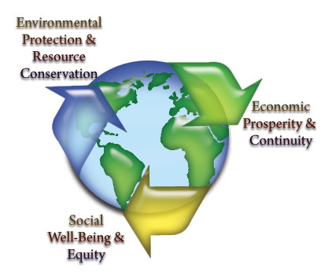
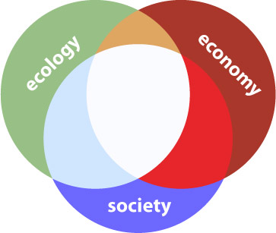
Catchment Analysis
Catchment Resource Availability
Ecological
Water Requirements
Socio-Economic
Water Requirements
Protection
Use
Water Resource Class
(Decision)

Slide 34
Water Resource Classes, catchment configuration and implications

Slide 35
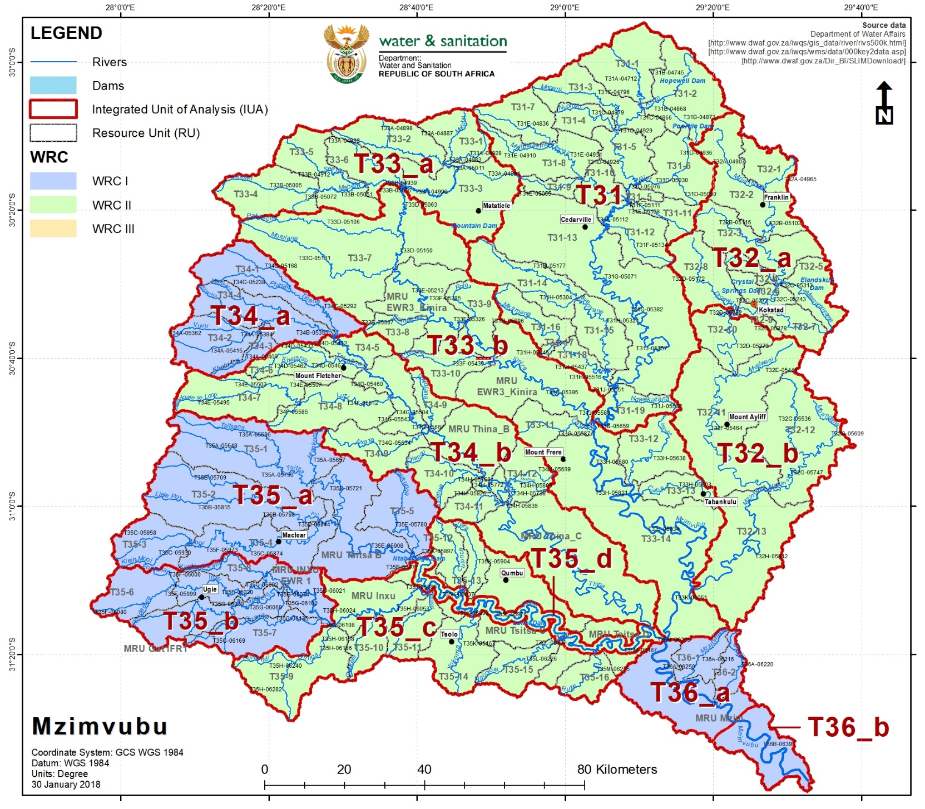
WATER RESOURCE CLASSES FOR T3

Slide 36
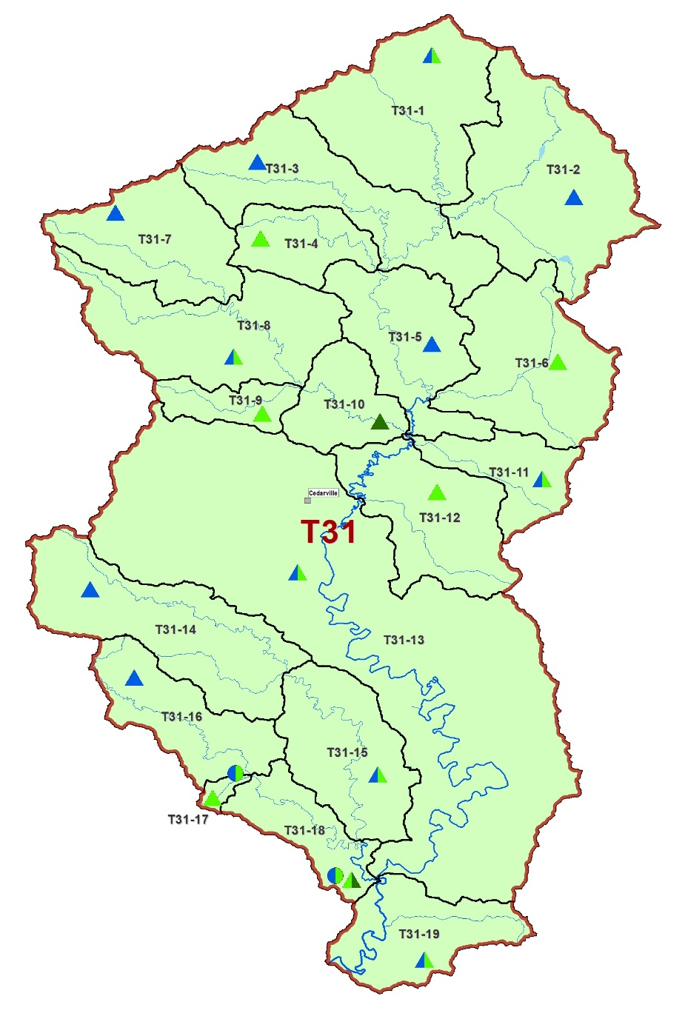


DRAFT CLASS: T31- MZIMVUBU
CLASS II
No direct impact on users/ economy and ecology
T31-17:
Sewage treatment, erosion control, improved agricultural practices, alien vegetation removal.
T31-18: Mkemane
Improve sedimentation (quality) – erosion control
WRC I
WRC II
WRC III

Slide 37
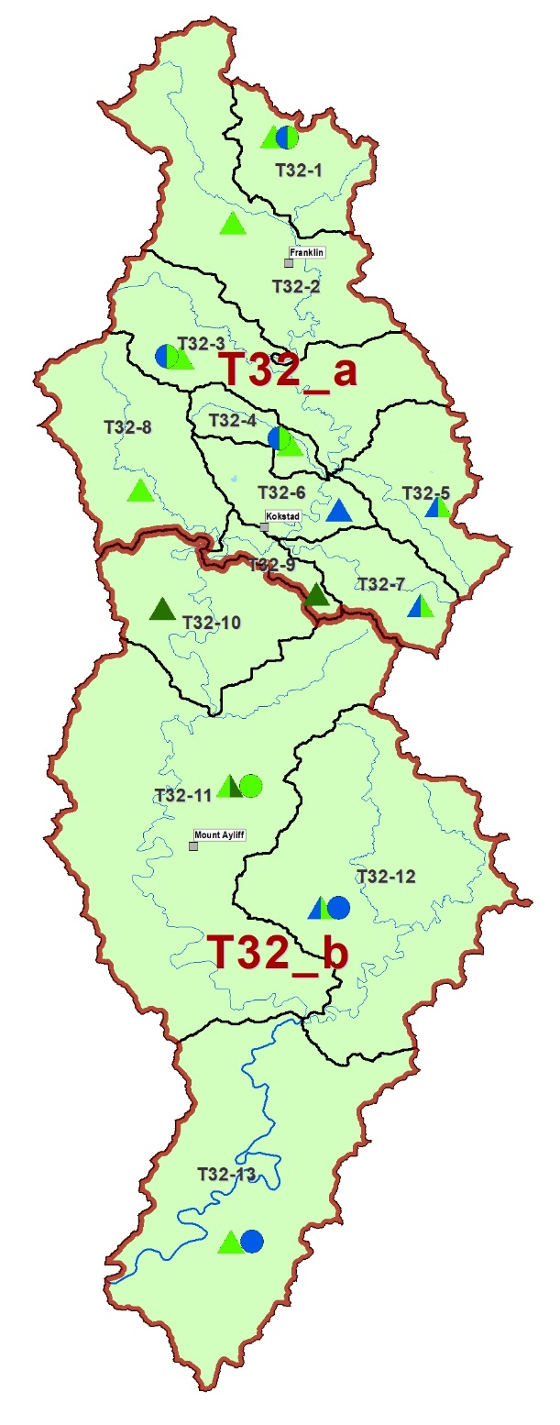

CLASS II
No direct impact on users/ economy and ecology
DRAFT CLASS: T32 - MZINTLAVA
T32-3:
Control irrigation etc.
T32-1: Mzintlava
Control and management of dams
T32-4: Mill Stream
Control flow and non-flow activities
T32-11: Mzalweni
Erosion control, improve agriculture, alien veg removal
T32-12: Mzintlavana
Erosion control, alien veg removal
Note: T32_b can only achieve Class II IF the improvements are made
T32-13: Mzintlava
Improve riparian buffer (floodplain agriculture)

Slide 38
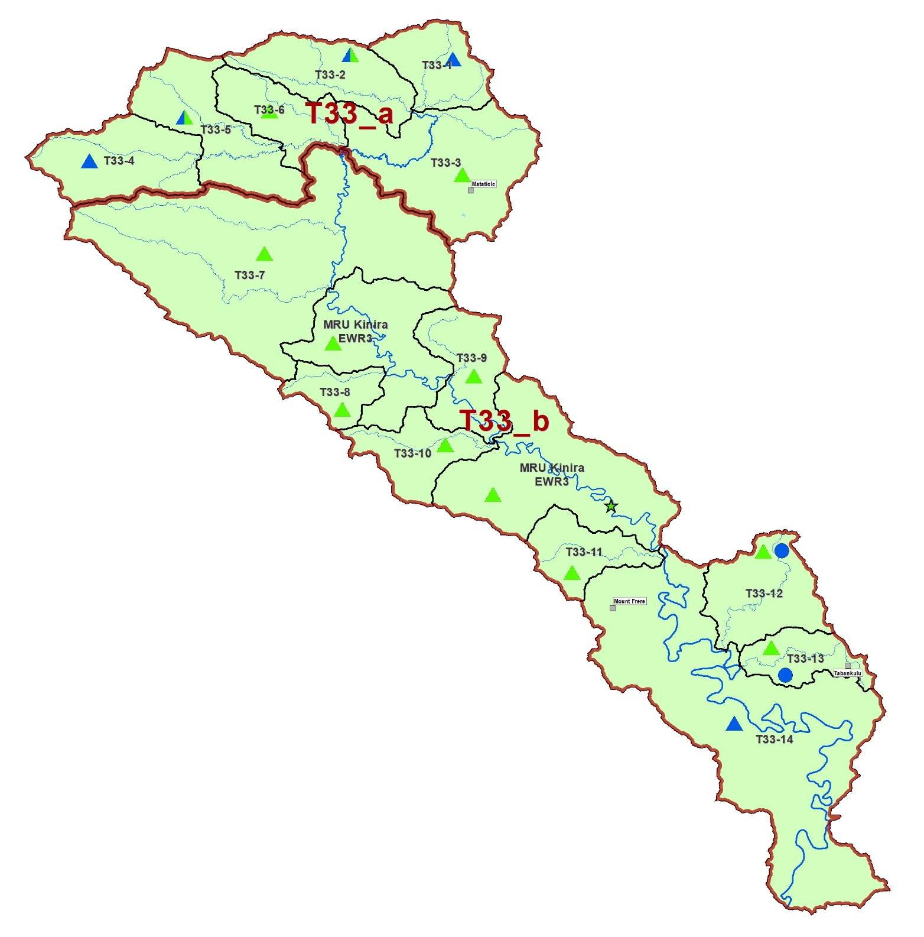
DRAFT CLASS: T33 - KINIRA
T33-13: Caba
Improve WWTW, erosion, riparian buffer.
CLASS II
No direct impact on users/ economy and ecology

Slide 39
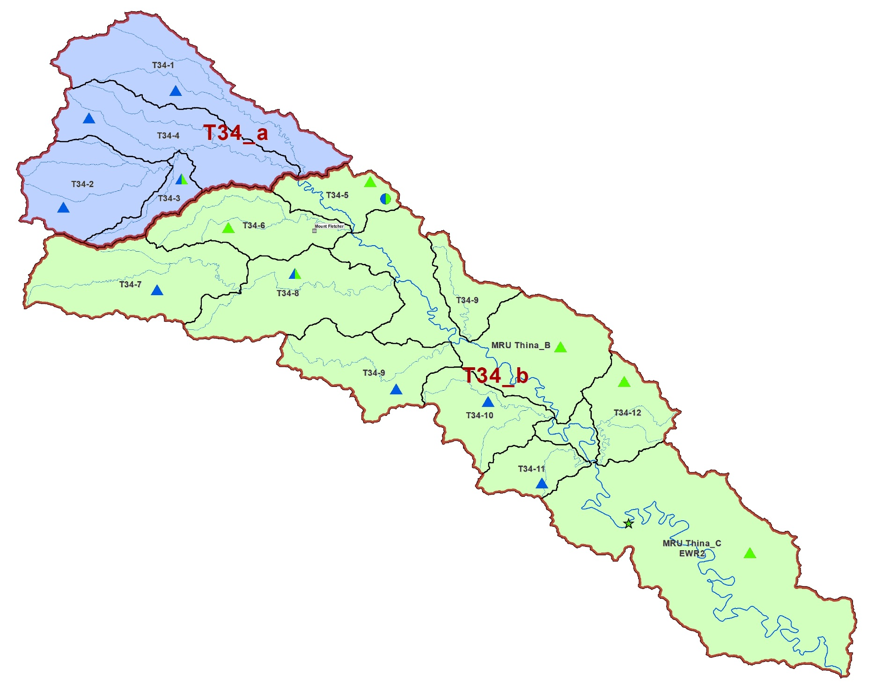
CLASS I
No direct impact on users/ economy and ecology
DRAFT CLASS: T34 - THINA
T34-5: Thina
Control and management of dam (supply EWR). Improve WWTW.
CLASS II
No direct impact on users/ economy and ecology

Slide 40
DRAFT CLASS: T35 – Tsitsa
Implications for future use
  The planned MWP includes 2 dams, Lalini & Ntabelanga, which will supply users and generate hydropower.
  Various scenarios of downstream releases were tested to determine an optimised way of managing dams that will ensure protection (maintain the ecological target) and maximise use.
  The scenario recommended is Sc 69.
  The Class will be the same whether the MWP is built or not. However, the EWRs will differ. The recommendations will include a with and without dams option.

Slide 41
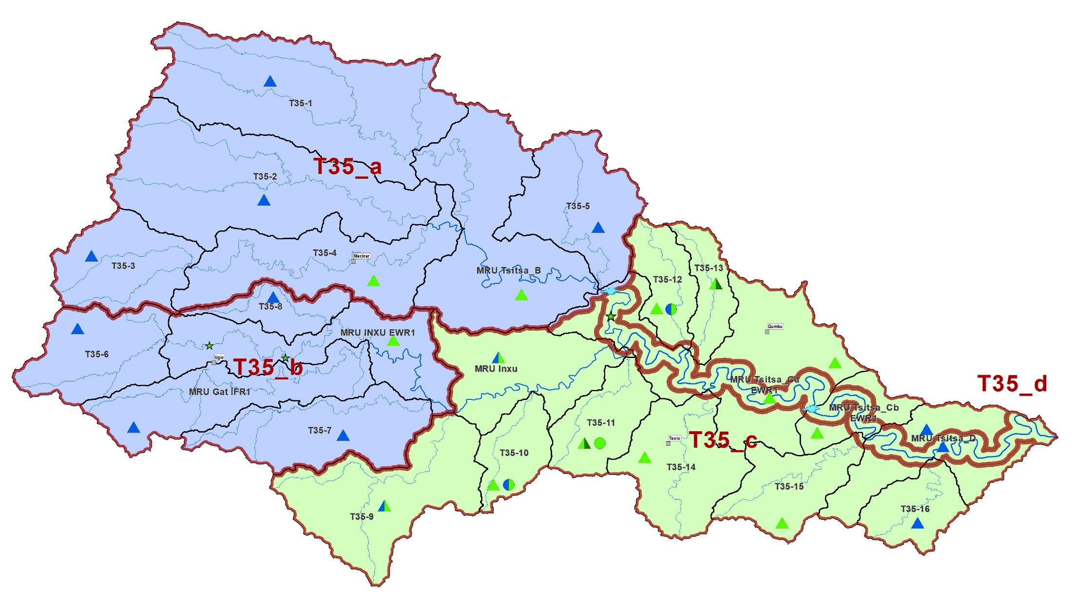
DRAFT CLASS: T35 - TSITSA
CLASS I
No direct impact on users/ economy and ecology
T35-10 (Qwakele), 11 (Ncolosi) & 12 (Culunca):
Riparian zone (erosion control and buffer zone)
MRU Gat IFR1:
Improve flows – manage dams
CLASS II
No direct impact on users/ economy and ecology

Slide 42
DRAFT CLASS: T35 - TSITSA
(MRU Tsitsa_d)
CLASS II : T35_d
Immediately applicable (pre-MWP): No direct impact on users/ economy and ecology Future implications (Sc 69): MzimEWR1: The overall ecological target will be met. However, the geomorphological and riparian vegetation target will not be met. This impact on the drivers does not impact on the responses and is deemed an acceptable balance. MzimEWR1-Lalini: River reach of 18 km will have minimal flow to keep Tsitsa Falls flowing (aesthetic and recreation). Ecological objectives for this reach will not be achieved. The rest of the RU will achieve the ecological objective. As long as reach stays perennial, this is deemed an acceptable balance.

Slide 43
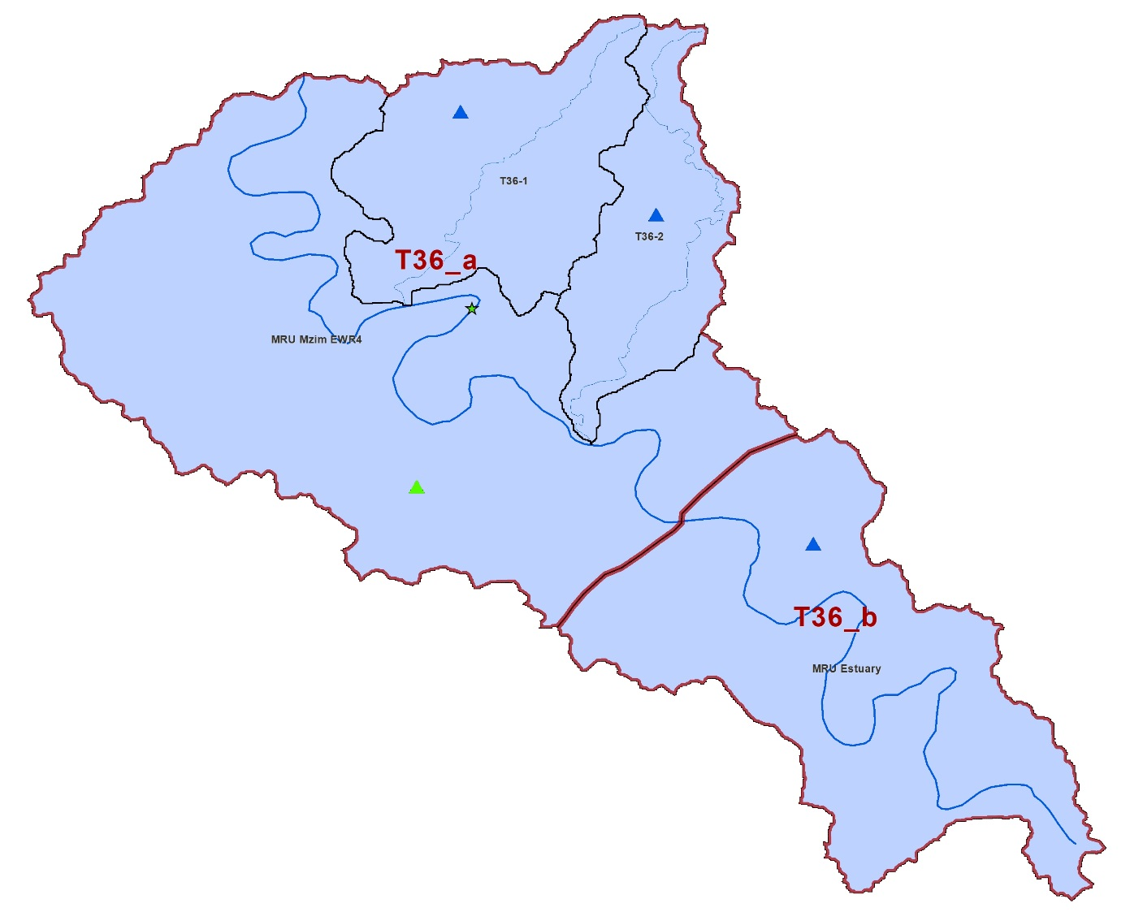
DRAFT CLASS: T36: MZIMVUBU
DRAFT CLASS: T36 - Mzimvubu
CLASS I : T36_a
No direct impact on users/ economy and ecology under present and future (Sc 69) conditions.
CLASS I : T36_b ESTUARY
No direct impact on users/ economy and ecology under present conditions. Future implications (Sc 69): The overall ecological target will be met. However, the following individual components will decrease in terms of the estuary health index score: Physical habitat, macrophytes, invertebrates, fish. These impacts are deemed an acceptable balance as the ecological target will be met.

Slide 44
Summary of present state vs ecological objectives vs target ecological objectives
  The Mzimvubu catchment is mostly in a Class II with some Class I sections.
  The Class recommendations are to maintain the current conditions.
  Future developments in terms of the MWP, including possible increased population and use, will not impact on the recommended Classes and Catchment Configuration if the MWP is managed according to Sc 69.
  Sc 69 was designed to represent an optimised scenario to create the balance between protection and use as is the requirements of the National Water Resources Classification.

Slide 45
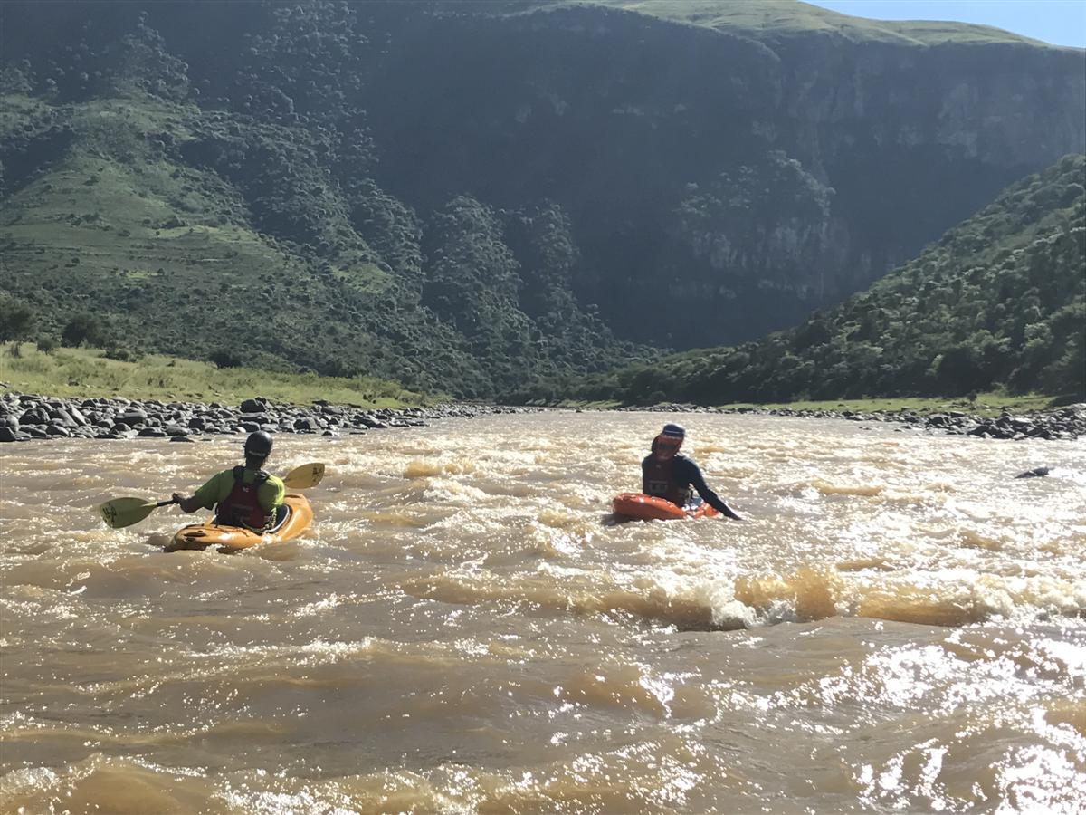
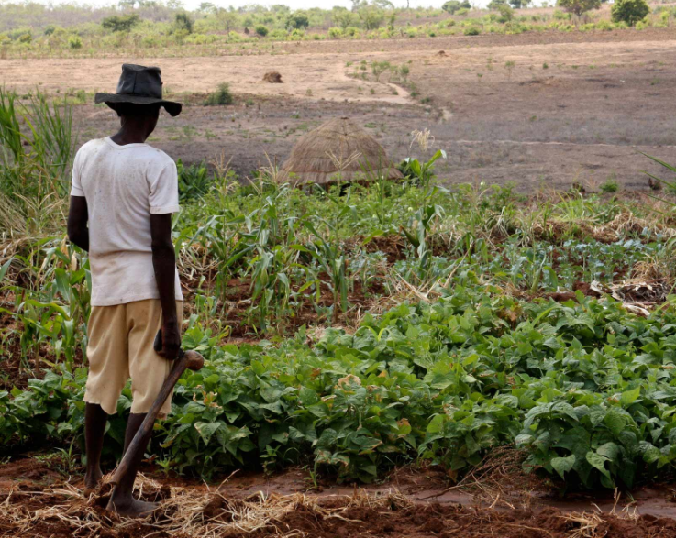
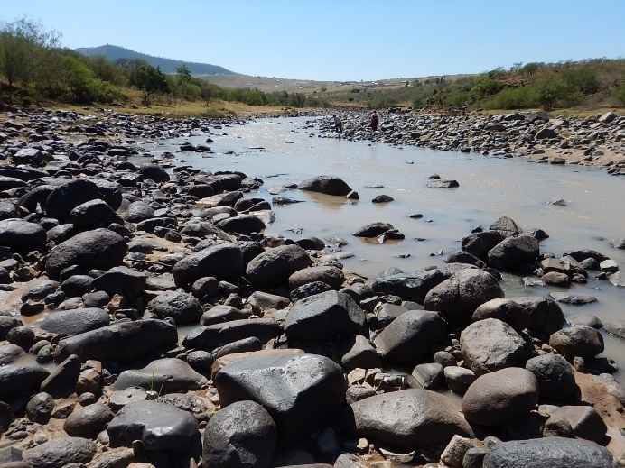
RESOURCE QUALITY OBJECTIVES

Slide 46
  RQOs and Water Resource
  Classes
Water Resource Class
Operational Scenarios
Informs
Defines
RQOs

Slide 47
  What are Resource
  Quality Objectives?
Resource Quality Objectives provide information to resource managers on how to manage the Integrated Units of Analysis to maintain or achieve the Water Resource Class and the ecological needs.
Resource Quality Objectives for a water resource are a numerical or narrative (descriptive) statement of the conditions which should be met to ensure that the water
resource is protected.

Slide 48
For which components/indicators are
RQOs set?
Quantity, pattern and timing of instream flow (hydrology).
Water quality (numerical values that define the fitness of use and/or ecological requirements for various variables).
Characteristics and condition of riparian habitat and biota (% alien vegetation, cover, species).
Characteristics and condition of instream habitat and biota (frequency of occurrence, species/taxa, abundance, habitat).
NOTE: Not all RQOs are set for all river reaches and estuaries – depends on priority and indicators selected.

Slide 49
Rivers
Wetlands
Estuaries
Groundwater

Slide 50
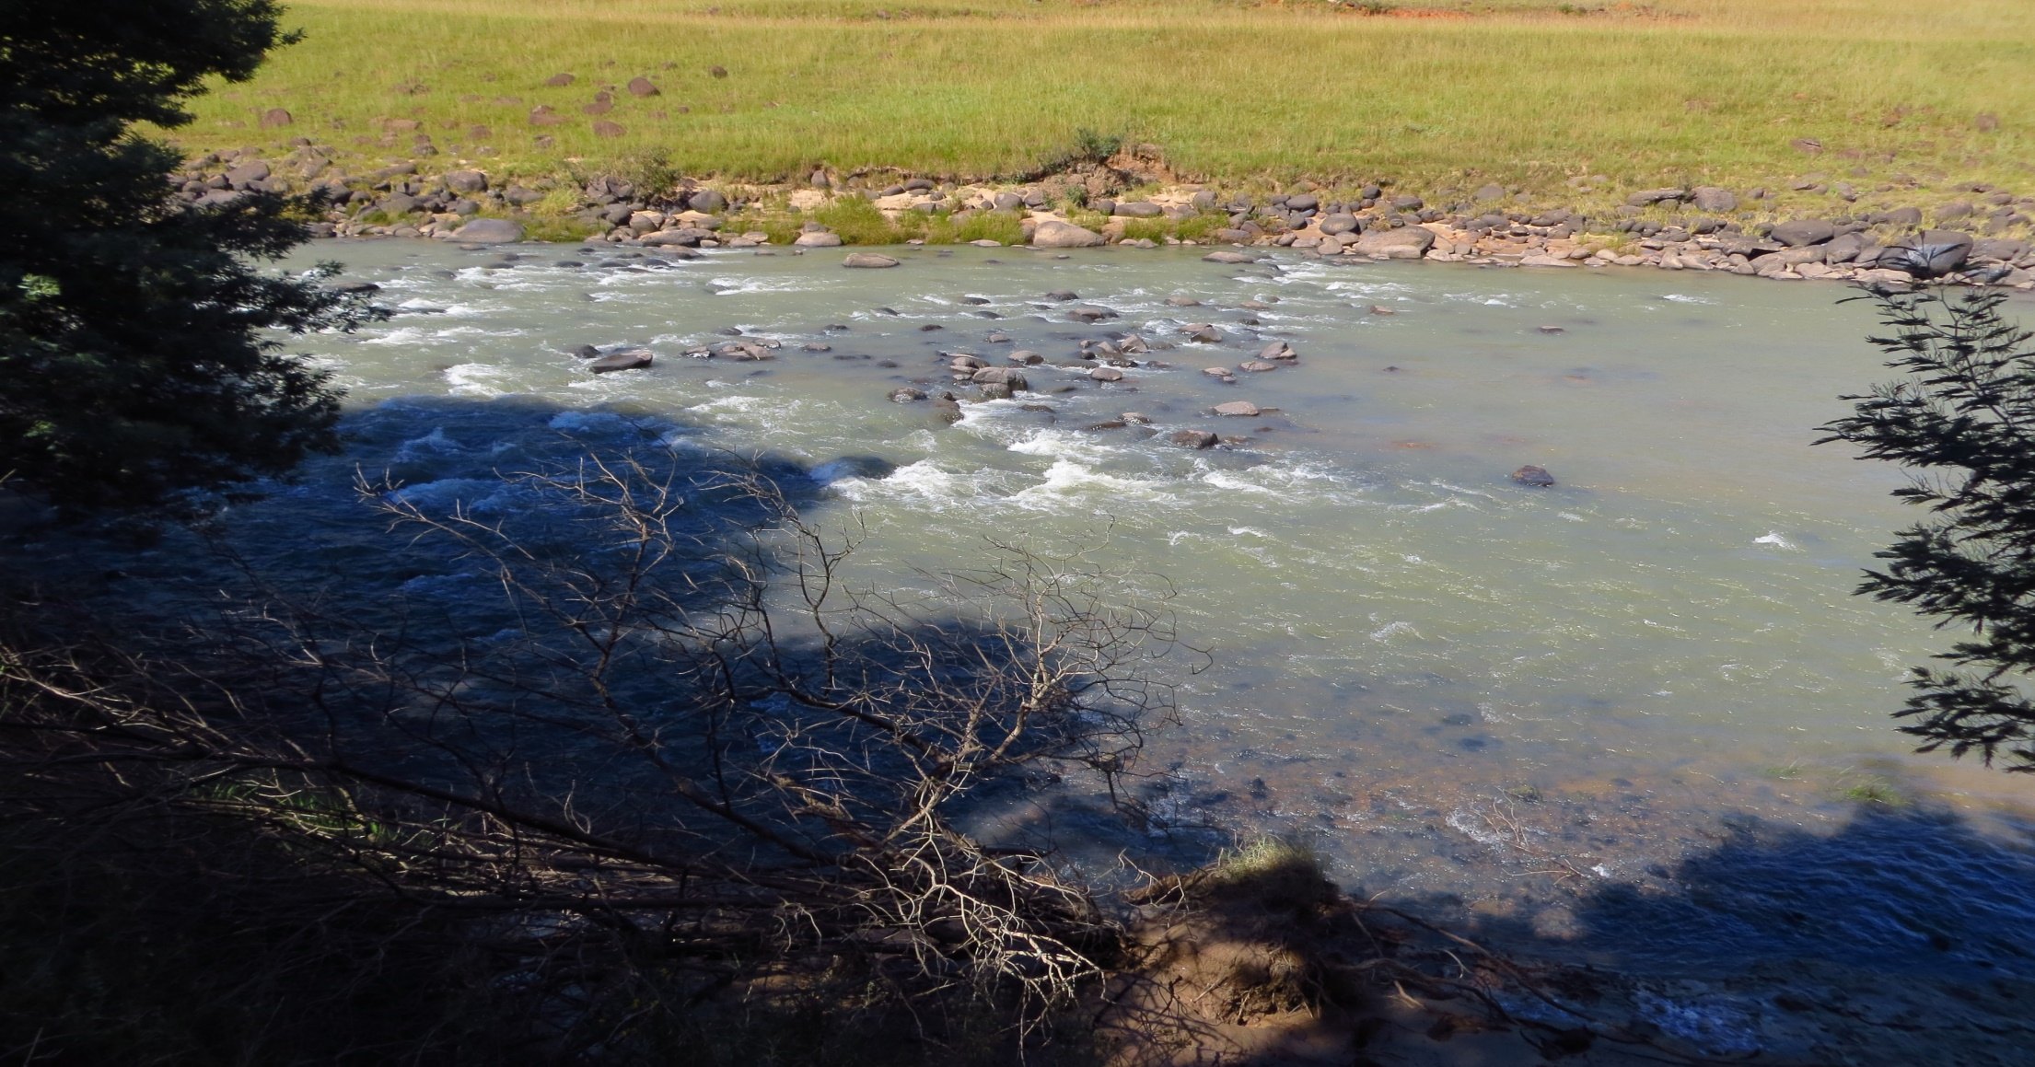

TSITSA RIVER - MZIMEWR1
 |  | PES | TEC
Hydrology | nMAR% | 31 | 31
 | Drought (90%) Aug | 0.66 m³/s | 0.66 m³/s
 | Aug (60%) | 0.8 m³/s | 0.8 m³/s
Habitat & Biota (EcoStatus C) | Geomorph | C/D | D
 | Water quality | B | B
 | Fish | C | C
 | Invertebrates | C | C
 | Vegetation | C/D | D

Slide 51
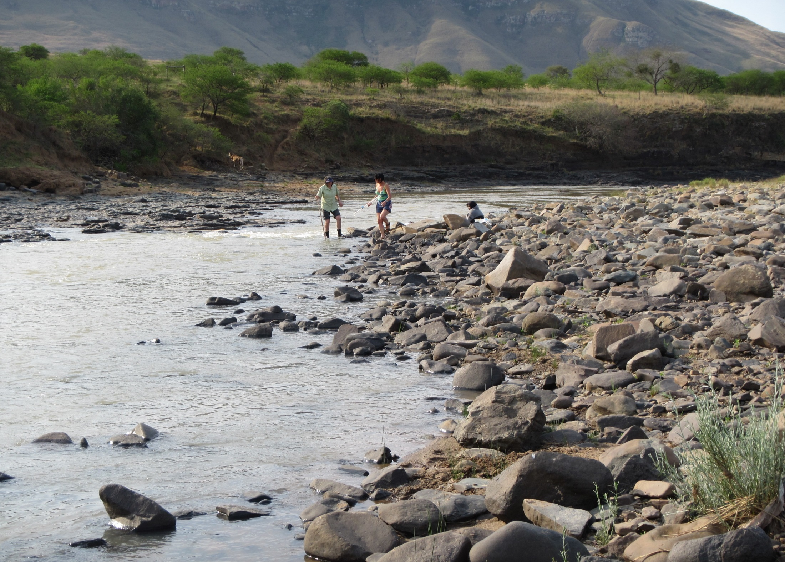
THINA RIVER - MZIMEWR2
 |  | PES / TEC
Hydrology | nMAR% | 30.1
 | Drought (90%) Aug | 0.7 m³/s
 | Aug (60%) | 0.8 m³/s
Habitat & Biota (EcoStatus C) | Geomorph | C
 | Water quality | B
 | Fish | B/C
 | Invertebrates | C
 | Vegetation | C/D

Slide 52
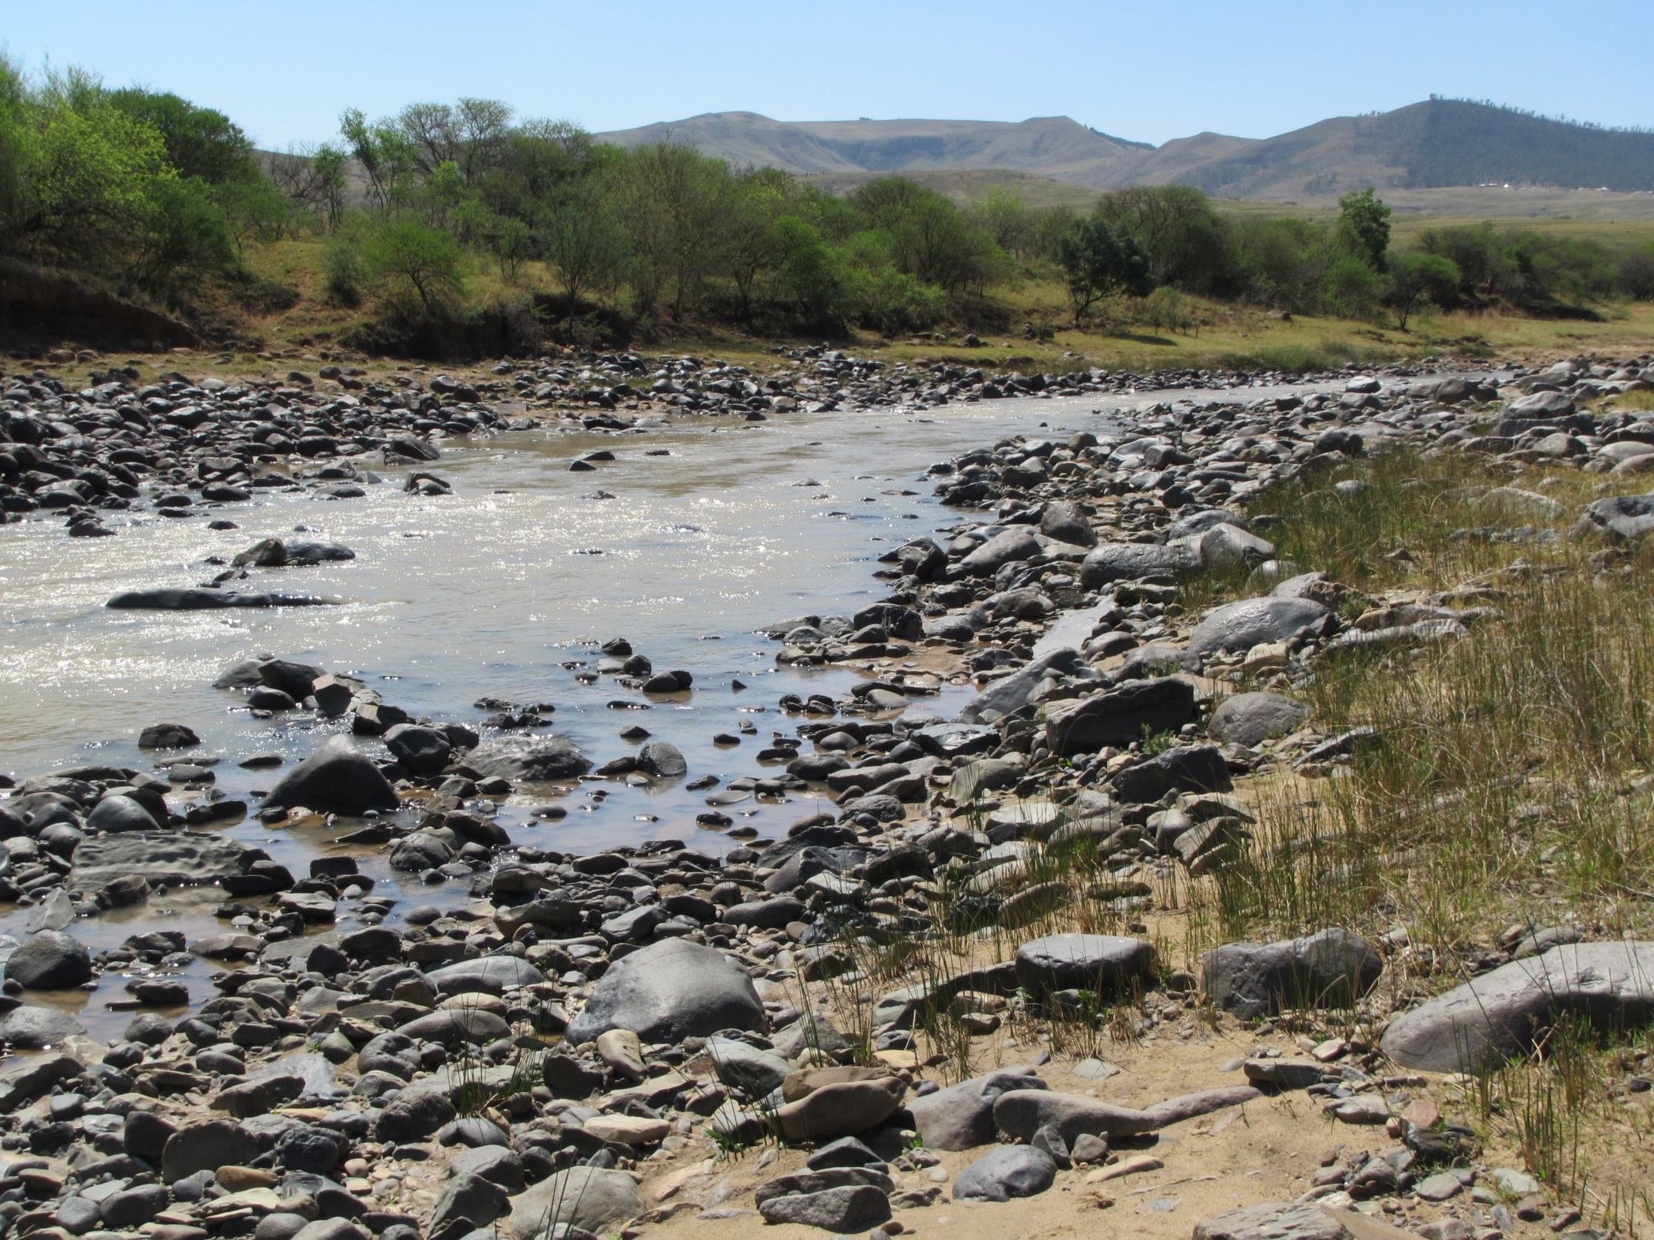
KINIRA RIVER - MZIMEWR3
 |  | PES / TEC
Hydrology | nMAR% | 33.3
 | Drought (90%) Aug | 1.647 m³/s
 | Aug (60%) | 3.037 m³/s
Habitat & Biota (EcoStatus C) | Geomorph | C
 | Water quality | B/C
 | Fish | C
 | Invertebrates | C
 | Vegetation | C/D

Slide 53
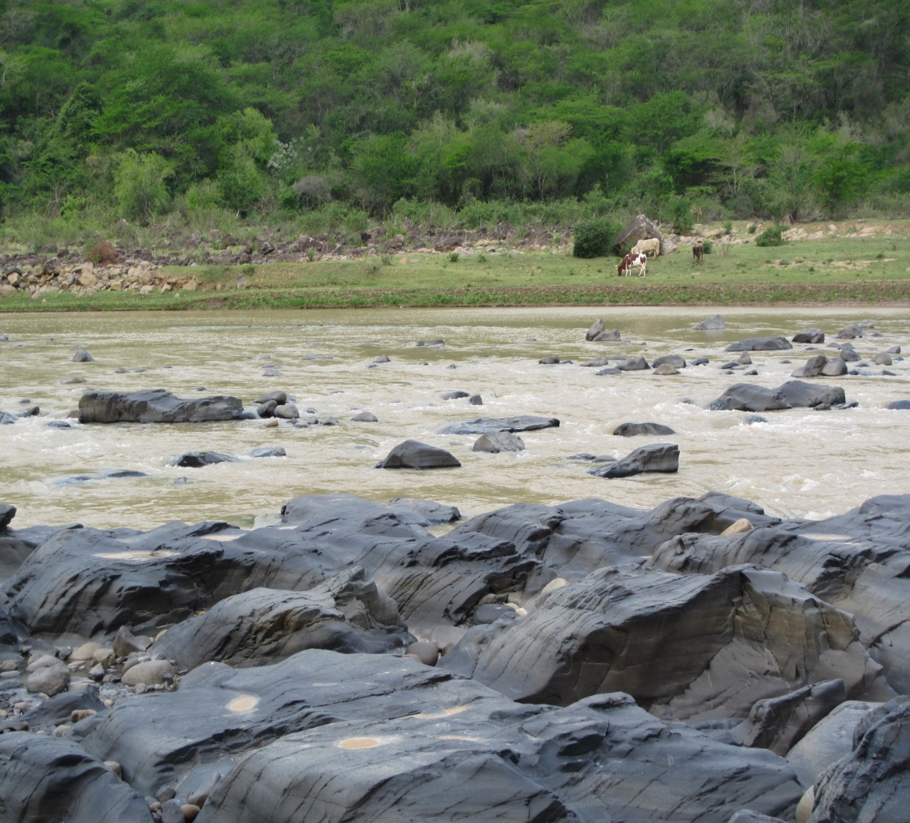
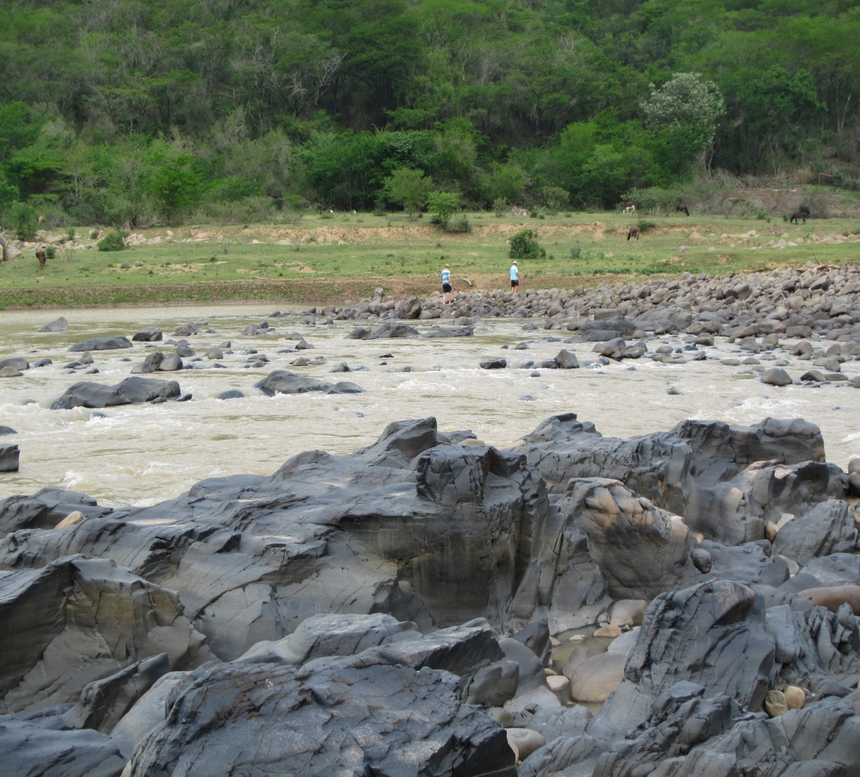
MZIMVUBU RIVER - MZIMEWR 4
 |  | PES | TEC
Hydrology | nMAR% | 23.8 | 23.8 - natural
 | Drought (90%) Aug | 3.12 m³/s | 3.12 - natural m³/s
 | Aug (60%) | 4.95 m³/s | 4.95 - natural m³/s
Habitat & Biota (EcoStatus C) | Geomorph | C | C
 | Water quality | A/B | A/B
 | Fish | C | C
 | Invertebrates | C | C
 | Vegetation | C/D | C/D

Slide 54
Water quality = two broad components
  Ecological, i.e. as part of the EWR or Reserve process. Output = EcoSpecs.
  Non-ecological or Users, i.e. UserSpecs (excl. aquatic ecosystems + includes users such as irrigation, stock-watering, domestic, recreation and industrial).
Water quality preparation for RQO step:
  ID wq hotspots
  ID wq role players, including non-ecological users e.g. irrigation, settlements.
  ID driving variables associated with indicator wq role players, e.g. elevated nutrients linked to WWTW.
  Identify indicators linked to driving variables , e.g. phosphate as the elevated nutrient.
  Aim is to identify pollution priority areas and / or priority protection areas.
  All information tested with stakeholders.
WATER QUALITY

Slide 55
WATER QUALITY HOTSPOTS

Slide 56
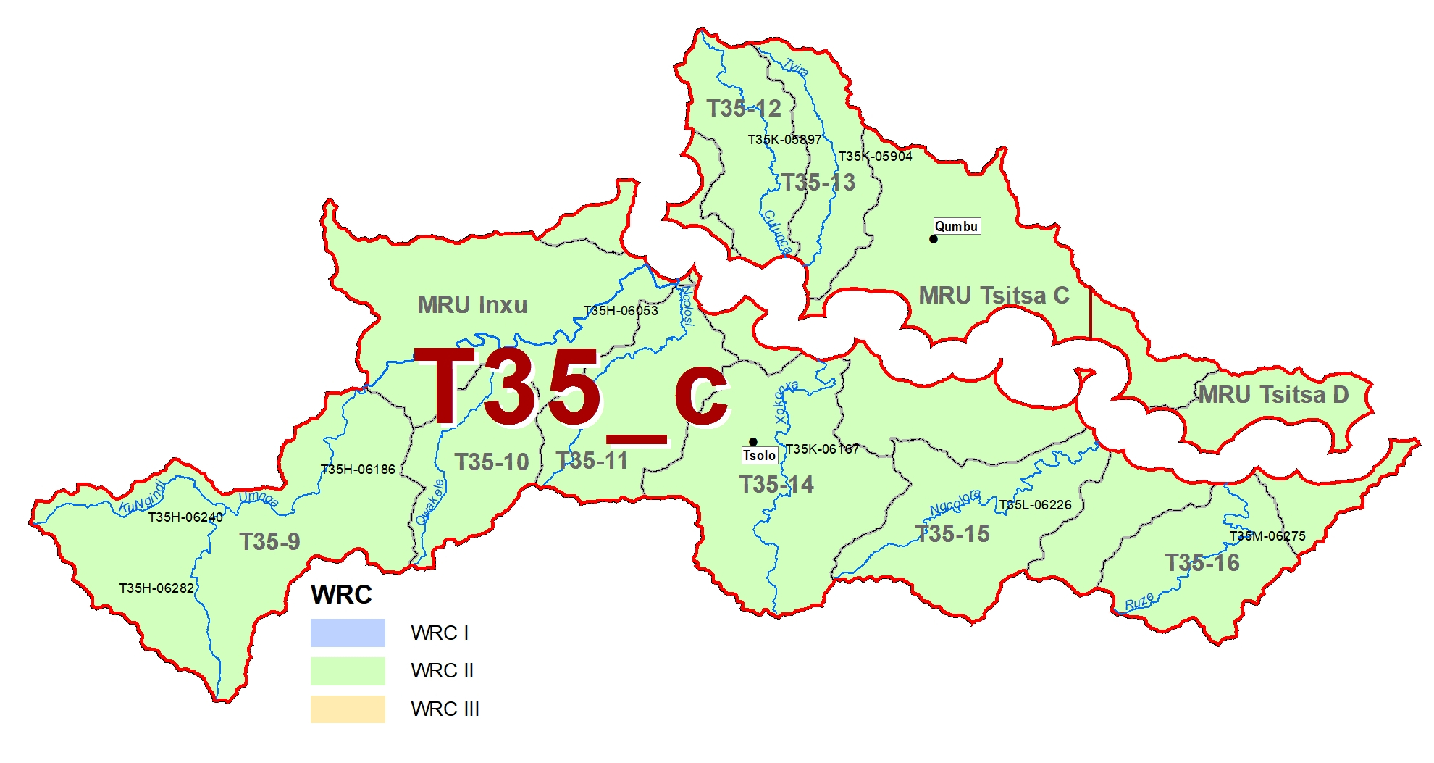
Land use: Extensive settlements; erosion + sedimentation.
Driving variables: Nutrients, faecal coliforms/E.coli
Land use: Ugie WWTW; urban impacts; irrigation downstream.
Driving variables: Nutrients, toxics, faecal coliforms/E.coli
Land use: Tsolo WWTW; urban impacts; crossings; dryland cultivation.
Driving variables: Nutrients, toxics, turbidity, faecal coliforms/E.coli
      WQ RQOs are expressed as Ideal to Tolerable in the gazette

Slide 57
Rivers
Wetlands
Estuaries
Groundwater

Slide 58
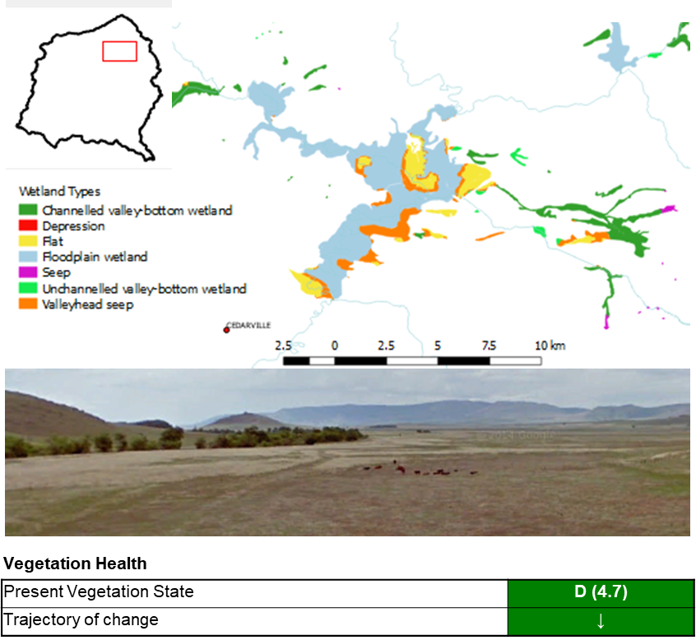
RQOs PROVIDED FOR:
Water quantity
  Hydrology
  Shallow flooding by damming
Habitat
  Wetland vegetation
  Loss/fragmentation due to agriculture and infrastructure
  Vegetation present state
Biota
  Endangered crane specIes
  Invasive alien species
MZIMVUBU FLOODPLAINS

Slide 59
Rivers
Wetlands
Estuaries
Groundwater

Slide 60


Mzimvubu Estuary RQO = Target Category B
Component | EC | Resource Quality Objectives*: Drivers
Hydrology | A | Protect flow regime to create required habitat for biota.
Hydrodynamics | A | Maintain mouth conditions to create the required habitat: Mouth not to close or become very constricted. Changes in tidal amplitude at the tidal gauge nor more than 20% from 2017 baseline.
Physical habitat (Sediments) | A/B | River inflow distribution patterns (floods) and suspended sediment concentration in river inflow not to deviate by more than 20% of present. No deviation in sedimentation and erosion patterns in estuary.
Water Quality (salinity) | A/B | Maintain salinity regime.
Water Quality (other) | C | Maintain the water quality to meet the target EC for both river inflow and in the estuary. Note a naturally turbid system. Metals in water and sediment not to exceed target values. Recreational guidelines specified.
*The RQOs provided here include some numerical information. All narrative RQOs supported by numerical RQOs are in the technical reports.

Slide 61



Mzimvubu Estuary RQO = Target Category B
Component | EC | Resource Quality Objectives*: Responses
Microalgae Macrophytes | C
Invertebrates | A/B
Fish | B/C
Birds | C/D
*The RQOs provided here include some numerical information. All narrative RQOs supported by numerical RQOs are in the technical reports.

Slide 62
Rivers
Wetlands
Estuaries
Groundwater

Slide 63
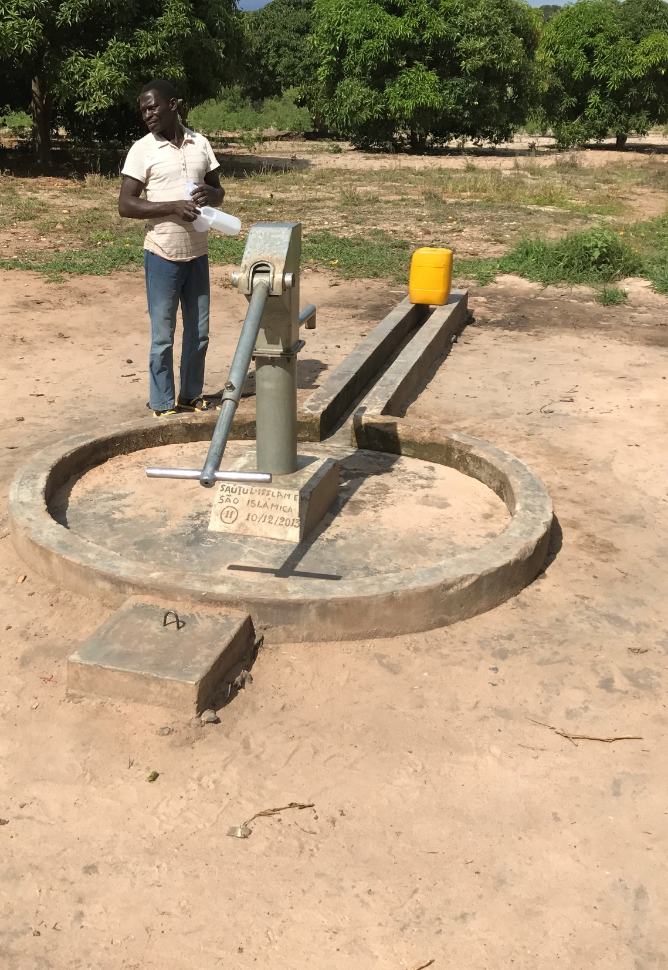
HOW DOES WATER USE AFFECT GW?
Abstraction: Reduction of groundwater baseflow by interception of GW or by drawdown and gradient reversal near rivers.
Alien Invasive Plants (AIPs): increased evaporation of shallow groundwater or reduce interflow from high lying areas.
Groundwater contributions to the EWR include:
Baseflow to rivers and springs, including high lying springs fed by interflow.
Seepage to wetlands and groundwater dependent ecosystems.

Slide 64
AIMS FOR SETTING GW RQOs
Maintain the required groundwater contribution to the EWR
Protect groundwater resources for the direct and indirect users
RQOs may stipulate:
  the volume of abstraction that would cause an undesirable reduction in baseflow or undue stress on aquifer
  specific distances from a river
  flow at gauging stations and maximum baseflow reduction
  GW levels
  water quality conditions (linked to potable use)

Slide 65
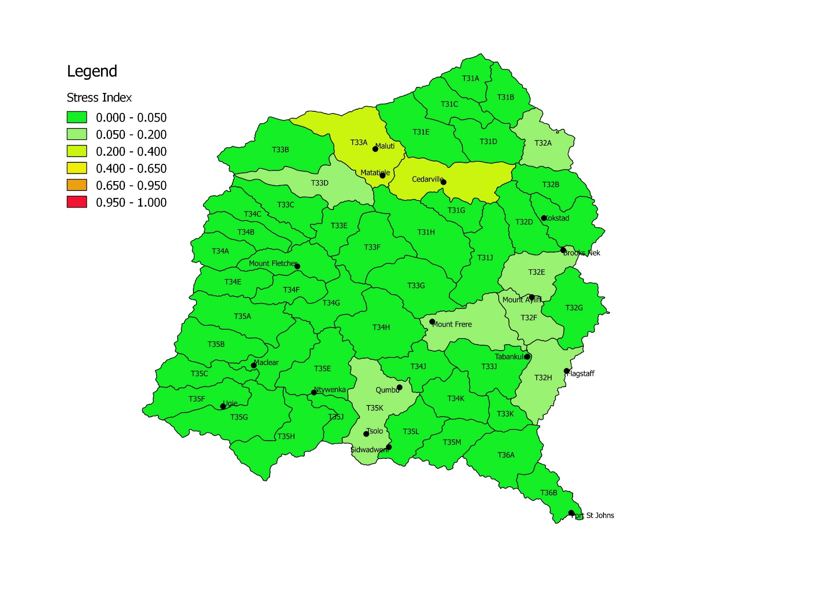
STRESS INDEX
So, groundwater in all catchments under-utilised.

Slide 66
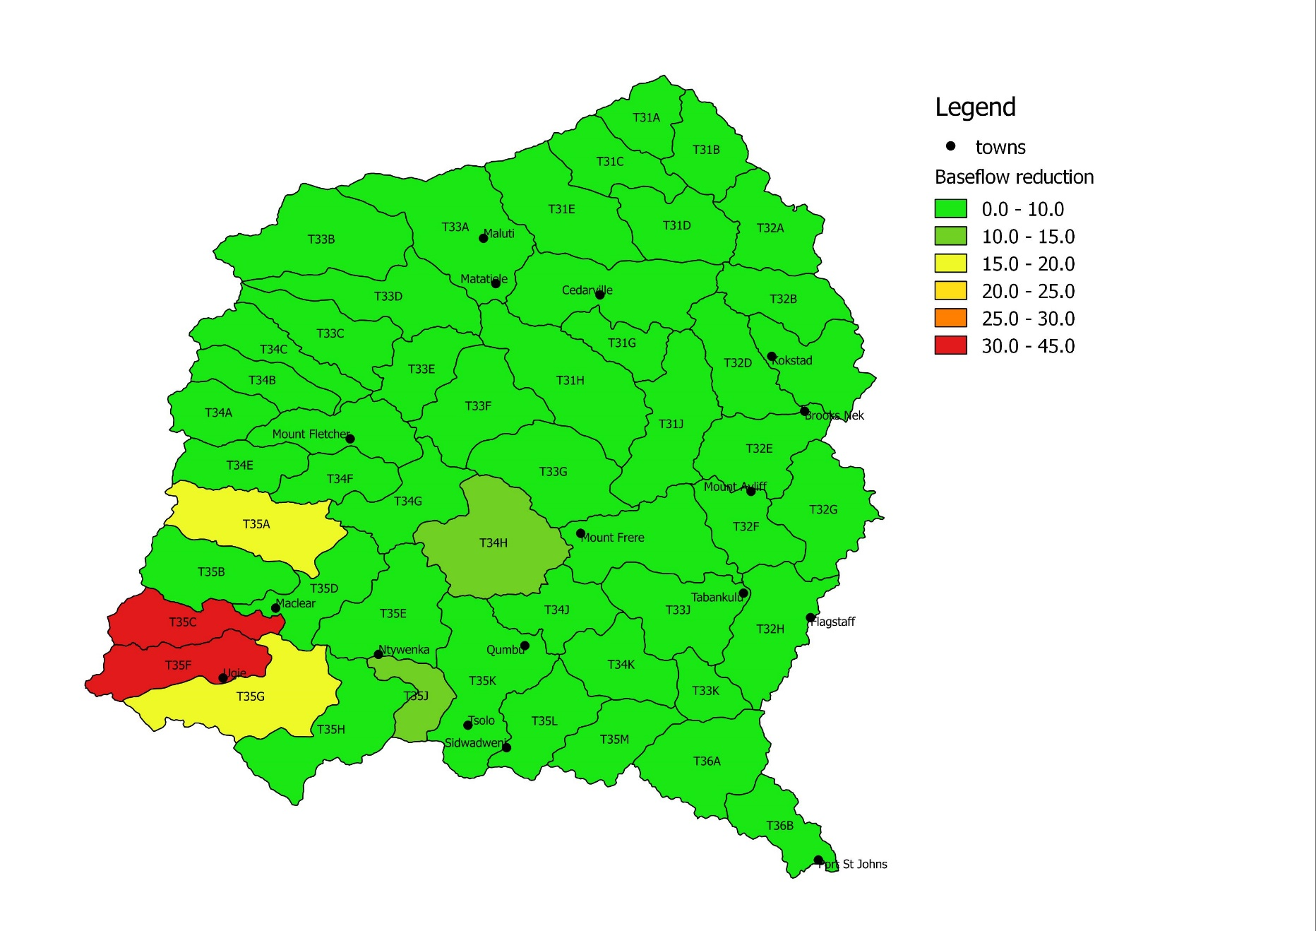
BASEFLOW REDUCTION

Slide 67
EXAMPLE: GW RQOs – Tsitsa: T35C, T35F (1 of 2)
Note: These catchments identified for low flow monitoring via gauging stations so as to assess streamflow reduction (SFR) impact on gw contribution to the EWR.
Abstraction:
All users to comply with existing allocation schedules, incl GA and Schedule 1, and individual licence conditions within the Harvest Potential.
Baseflow:
Due to baseflow depletion, further SFR activities should be restricted to use less than the GA.

Slide 68
EXAMPLE: GW RQOs – Tsitsa: T35C, T35F (2 of 2)
Water level monitoring:
Due to low use and low contribution to baseflow, not needed.
Water quality:
Some boreholes may have elevated levels, so nitrate and fluoride need to be tested for domestic boreholes.
Insufficient data exists, and data collection is required.
Numerical RQO:
Low flows at T3H009 should not be less than an average of 8.92 Mm³/a for T35C.
T35F is ungauged and cannot be monitored by flow measurements.

Slide 69
CONCLUDING REMARKS

Slide 70
Concluding Remarks (1 of 2)
The recommended Classes and RQOs provide for appropriate protection. Utilisation of water resources is possible to sustain current and future socio-economic imperatives.
The MWP catchment (under Sc 69, with dams in place) should be carefully monitored and controlled and upstream development should be limited as this will impact negatively on the economics of the scheme.
Sc 69 meets PES or REC requirements for all biophysical nodes.

Slide 71
Concluding Remarks (2 of 2)
Implementation and monitoring of the RQOs will required intensifying the cooperation among institutions, for optimal use of resources and to aim higher towards achieving the goals of Integrated Water Resource Management.
The classification of the water resources is a further step to realise Integrated Water Resource Management

